Slide 1
Architecture in Systems
Integrated Care Systems (ICS)

Slide 2
Architecture in Systems
Integrated Care Systems (ICS)
Coordination
Joined up/integrated care
Pooled budgets
Integrated Care Boards
(pending Health & Social Care Bill)
Responsible for NHS functions and budgets
Integrated Care Partnership
(pending Health & Social Care Bill)
Statutory committee bringing together all system partners for health and care strategy
https://www.england.nhs.uk/integratedcare/
https://www.kingsfund.org.uk/audio-video/integrated-care-systems-health-and-care-bill
Examples of NHS England/Improvement Role
Support ICSs towards self-governance and assurance
Facilitate join-up between key system partners where needed
Support understanding of funding streams, planning requirements, and interpretation of policy/deliverables
Targeted support for system improvement and/or transformation – including facilitating roll-out of best practice
Facilitate or support programmes of work that are most efficiently “done once” at regional scale
Interface between National NHSE/I team and ICSs
Notes:
GIVE EXAMPLES OF NHSE/I ACTIVITY

Slide 3
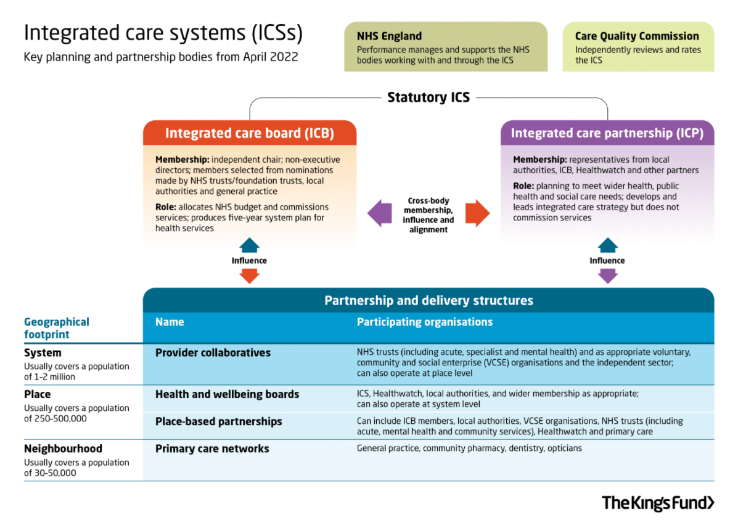
Architecture in Systems

Slide 4
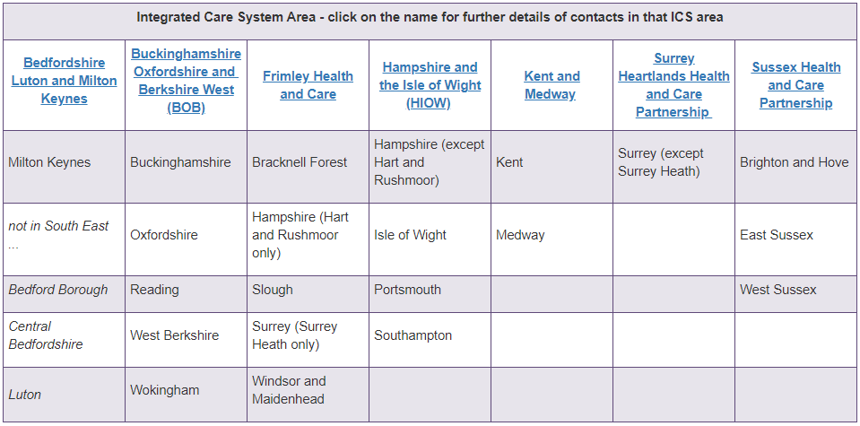
Architecture in Systems
Which Local Authorities Are Within Which ICS Footprint?
https://seslip.co.uk/contacts-and-links/ics

