Slide 1
The South East Memorandum of Cooperation 2022
Guide for Managers and HR Professionals

Slide 2
What is the Memorandum (MoC)
The Memorandum of Cooperation (MoC) is a voluntary agreement between 19 local authorities in the South East of England.
It is designed to encourage authorities to work more collaboratively across the region to manage the demand and supply of children’s social workers.
Notes:
Add notes into this slide explaining why the MoC is important to your authority.

Slide 3
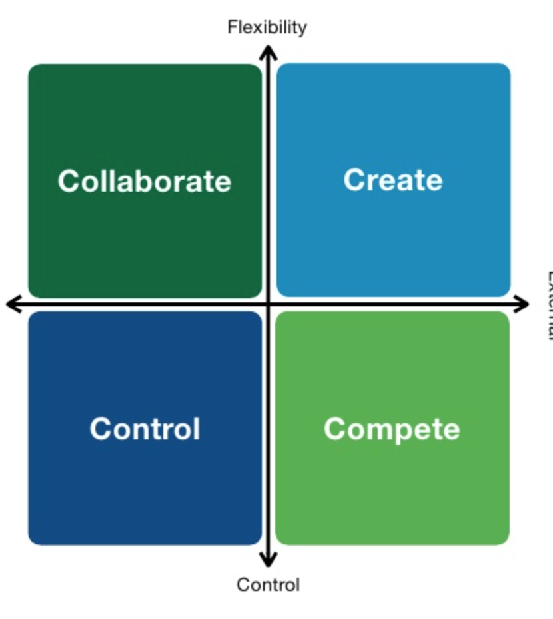
Why is the MoC being implemented?
Councils have historically competed to recruit and retain children’s social workers in the context of shortage in supply
The MoC aims to develop a more collaborative and creative approach to the problem
Notes:
Fierce competition between LAs has benefitted agencies who use the competition to fuel instability in the workforce and higher rates of pay for agency staff. This is bad for children and the permanent workers who work alongside agency workers. The competition also acts to destabilize teams and services. Working together LAs can have a more powerful influence in the social work labour market.

Slide 4
Is the MoC Unique to the South East?
No, many other regions have similar arrangements in place
The East of England have had one since September 2014
Every region bordering the South East has a MoC

Slide 5
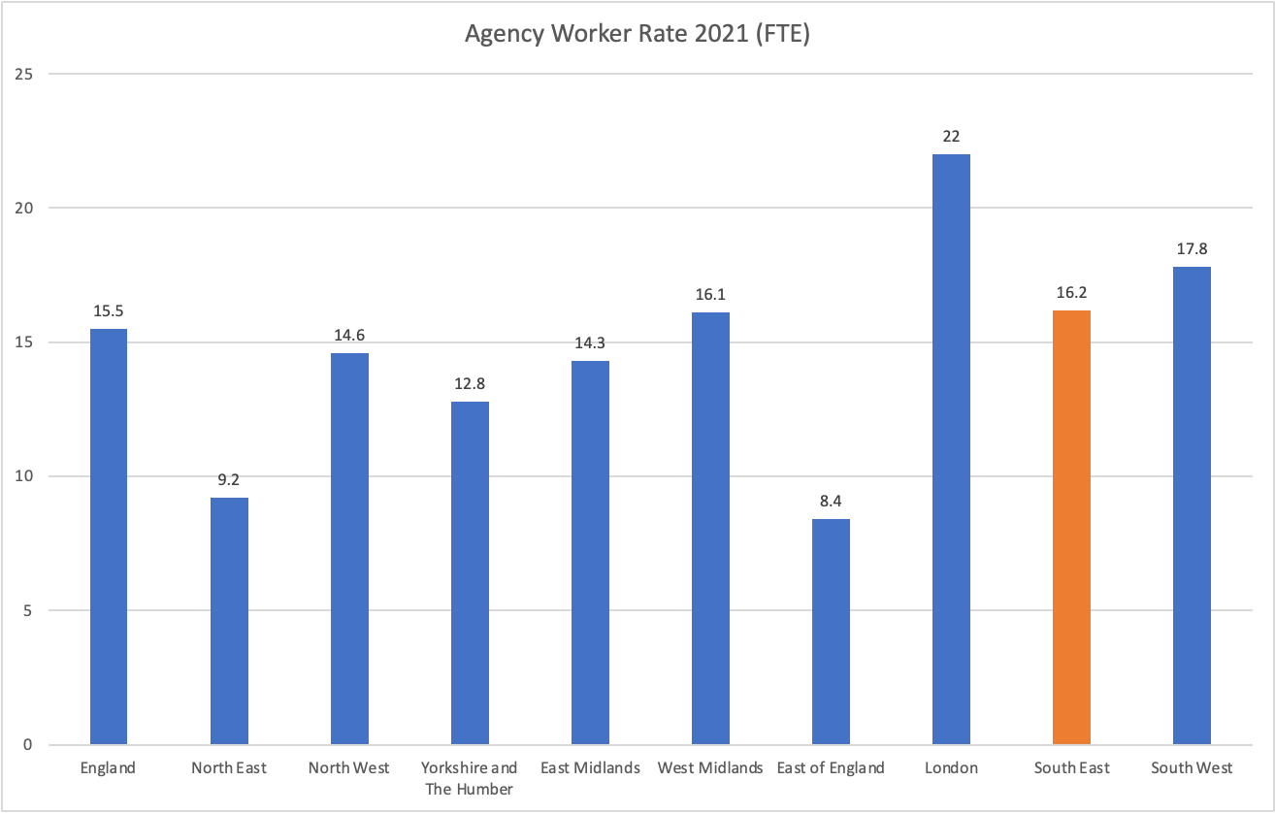
In 2021 the South East had the 3rd highest agency worker rate of the 9 English Regions (Only London and the South West are higher)

Slide 6
Why is the MoC being re-launched?
Agency workers have an important role to play in the workforce
However, over reliance on agency workers is bad for children and social workers
Ofsted identify excessive turnover of staff as a key issue for children’s services
Agency staff cost 25-40% more than directly employed staff
Notes:
It is important to identify the MoC is not just about saving money, it is also to improve services for children. Agency workers have a place covering gaps and when staff are needed at short notice, but too many are not good for children or the permanent staff. The MoC is an attempt to re-balance the workforce and reverse the trend for ever greater reliance on agency workers.

Slide 7
Impact of Agency Staff
Recent analysis has illustrated a linkage between the number of agency staff in a local authority children’s services and the Ofsted grading achieved:
  Outstanding = 6.4%,
  Good = 15.1%,
  RI = 16.4%
  Inadequate = 27%
  Average numbers based on 2020 data source Community Care 24.09.21

Slide 8
Which authorities are in the SE MoC?
Bracknell Forest
Brighton and Hove
Bucks
East Sussex
Hampshire
Isle of Wight
Kent
Medway
Milton Keynes
Oxford
Portsmouth
Reading
Slough
Southampton
Surrey
West Berks
West Sussex
Windsor and Maidenhead
Wokingham

Slide 9
Quality of Agency Staff
In addition to the cost of agency staff there are also concerns about the quality
There are examples of poor quality agency staff being recycled between authorities, often leaving cases in poor order
Rapid turnover of agency staff and limited use of references contributes to this issue
The MoC supports use of a standard reference for agency staff

Slide 10
4 Key Aims of the MoC
Improve the quality of referencing for agency workers
Stop local authorities aggressively head hunting staff from each other
Stop the costs of agency staffing from continuing to escalate
Remove the incentives for permanent staff to choose agency work

Slide 11
Standard Reference for Agency Workers
We have a standard reference template that should be used for all agency workers
It needs to be completed comprehensively and honestly
It needs to be completed by the manager of the last assignment

Slide 12
Agency Pay Cap
We have agreed that we will not exceed agreed pay caps for agency staff
This is the hourly rate paid to the worker excluding the agency fee
The rates are caps and negotiations should always start at the bottom of the range
Agency Role | PAYE Rates | Paid to Employing Agency (amount in respect of Employers NI and holiday pay) | MoC Cap Inclusive of Employers NI and holiday pay (for Ltd company and Umbrella Rates)
Team Manager | £38.12 | £9.38 | £47.50
Assistant Team Manager | £33.71 | £8.29 | £42.00
Senior Social Worker | £33.71 | £8.29 | £42.00
Social Worker | £30.50 | £7.50 | £38.00

Slide 13
What do we do if we are unable to recruit staff within the agreed pay cap?
The pay cap has been calculated considering actual rates paid in the region. Consequently it is realistic and it should be possible to secure staff within the agreed range
The cap applies to new assignments from the 1st April 2022 (i.e. does not effect existing arrangements made prior to the MoC)

Slide 14
Removing the incentive for permanent staff to move to agency work
Any children’s social worker leaving a permanent contract will not be employed on an agency contract by another authority in the region within 6 months. This would not apply to permanent staff moving to permanent roles in other authorities within the region. Social workers who are made redundant from a permanent post will be exempt from this requirement.
Notes:
2 LAs have sought legal advice on this clause and it does not impinge on any ones right to work, it simply requires them to either accept an LA contract or work outside the participating authorities for a six month period. The East of England Region have had this arrangement in place since September 2014

Slide 15
When hiring agency staff
Check that they have not worked as a permanent children’s social worker in one of the authorities signed up to the memorandum in the last 6 months prior to offering an agency role.
There is nothing to stop staff moving from a directly employed role in one authority to a role in another, this only applies to permanent staff joining agencies
Workers who have been made redundant by their last authority are exempt from this clause

Slide 16
Summary
The new MoC is operational from the 1st April 2022
Do not employ agencies to use headhunting techniques in the region
Ensure references are comprehensive and honest
Only employ new agency staff within the agreed pay caps
Do not employ agency workers who have been permanent workers in another SE MoC authority within the previous six months

Slide 17
Questions about the MoC
If you have any questions about the MoC please contact
  Add contact details for local lead on the MoC
Notes:
This could be your representative who attended the MoC Implementation group, if you are unsure about a question please do not hesitate to contact Mark Evans (Mark@markeavnsconsulting.co.uk tel 0780 314 7072)

