Slide 1
SESLIP Continuing Care Session
Suzanne Smith
Hayley Maspero
April 2023

Slide 2
Then Now
2017/18
9 eligible children
£75k of income
Issues with relationships
Understanding of the framework
2022/23
71 eligible children
£3.7m of income
Standard Funding Model
Permanent Team

Slide 3
Initial Business Case
The review of the health landscape identified the following shared issues that required resolution to move forward:
The team comprised:
the pressures on the CCG CC budget and the backlog of CC assessments.
Individualised approach to agreeing funding splits.
Different processes for different types of need.
Increases in placements for children eligible for S117 after care and with challenging behaviour.
Perceptions regarding outstanding contributions from Health,
With an appropriately resourced improvement programme in a centralised team to manage health and health funding issues to improve consistency, understanding of the process and increase the quality of referrals.
Senior manager with delegated decision-making authority
Operational manager
Senior administrator

Slide 4
Outcomes
The team was established in Q3 of 18/19.
By Q3 of 20/21:
number of children eligible for CC increased by 64
increase in health income of nearly £1m.
Based on the teams performance, the team was made permanent in April 2021 at a cost of £168k per year.
Key to the success of the team was the implementation of the Multi Agency Resourcing Panel (MARP) which is co-chaired between Health and Children’s Services and has equal voting rights between Health, Social Care and Education.

Slide 5
Standardised Funding Model
The overall aim of implementing a standard funding model was to:
Streamline processes improving the experience for children and families
Free up staff time to increase throughput to meet statutory timelines
Enable social workers to spend more quality time with children and families working towards improved outcomes
Be congruent to improving partnership working relationships.
Objectives
Agreed joint objectives to
Implement a transparent and easy to use standard funding model.
Improve outcomes for children and families.
Overcome barriers to effective partnership working.
Approach
We baselined the current staff time and cohort costs and completed from financial modelling for the shortlisted options below;
Negotiation mode (Current model)
Even splits
Domain model
In terms of direct cohort costs, the even splits model estimated a 5% increase to Health and the domain model 6% to Children’s Services. For staffing costs we assumed that the negotiation and domain models would require more staff time to implement.
We completed a joint options appraisal where we scored the options against the following critical success factors;
Improves outcomes and experience for children and families
Transparent and easy to apply which reduces staff time
Aligns with outcomes based commissioning
Congruent with partnership working
The highest scoring option was the ‘Even splits’ model because this best met the critical success factors.
Notes:
The demand for Continuing Care services was growing due to advancements in medical technology ensuring longer lives for children with the most complex physical needs and changes to the framework which recognised the health needs of children with challenging behaviour.
The process for establishing eligibility and funding was complex, timely, resource intensive and did not comply with guidance to establish eligibility within 6 weeks of referral.

Slide 6
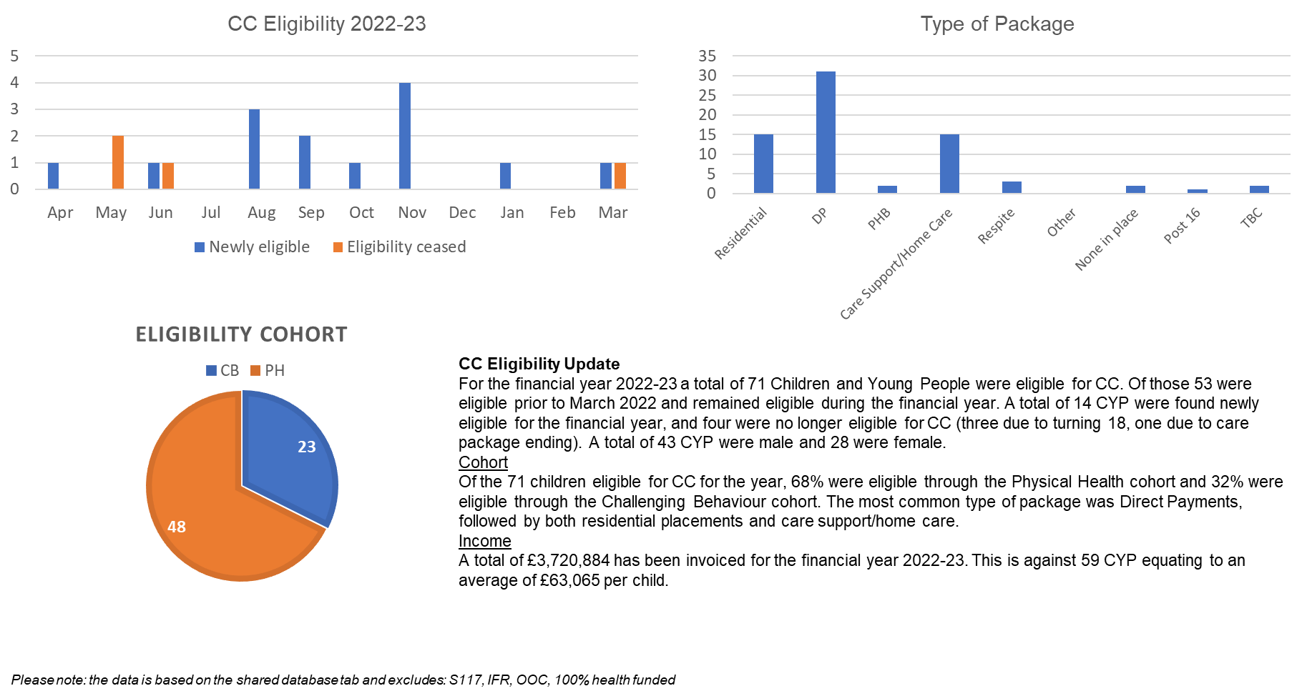
The numbers

Slide 7
Issues and Challenges
CC or not CC
Capacity to assess
Met need – withdrawal
Complex and challenging behaviour
CAMHS
Anything we would have done differently?
Capacity for change
Closer working with placements and commissioning

Slide 8
Next Steps
Review decision making framework and standard funding model.
What could an integrated model look like.
Streamline financing – pooled budgets?
MH Protocol and development of bespoke placements.
Joint funding arrangements that do not meet the threshold criteria for CC.
Closer working with AHC CHC colleagues to share learning and improve transition.

Slide 9
Questions

