Slide 1
SEND for LMCS
Getting it right for children and young people with SEND, and their families.
Deborah Glassbrook

Slide 2
Objectives
To explore political leadership challenges in relation to the SEND agenda.
To inform you of some of the key changes in relation to SEND & new inspection framework.
To equip you with knowledge you can use to influence and lead improvement in your local SEND system and provide effective challenge and support.
A chance to network and share learning.

Slide 3
Under the Children & Families Act 2014 Local Authorities must…
Have regard to the Special Educational needs and disabilities code of practice: 0-25 years.
1
Take account of the views, wishes & feelings of children, young people and their parents.
2
Keep educational and care provision for these children under review consulting with young people directly.
3
Make advice & information available to children, young people and their parents – SENDIAS services – national minimum standards.
4
Review EHCP’s annually.
5

Slide 4
Under the Children & Families Act 2014 Local Authorities must…
From Year 9 (14 years) EHCP annual review must include a consideration of preparation to adulthood & transition planning to be built into the plan.
1
Make arrangements for ensuring co-operation across the LA to support successful transitions to adulthood
2
Publish a ‘Local Offer’.
3
Put in place co-operation across local partners for Personal Budgets – parents & young people have the right to request this.
4
6
7
8
9

Slide 5
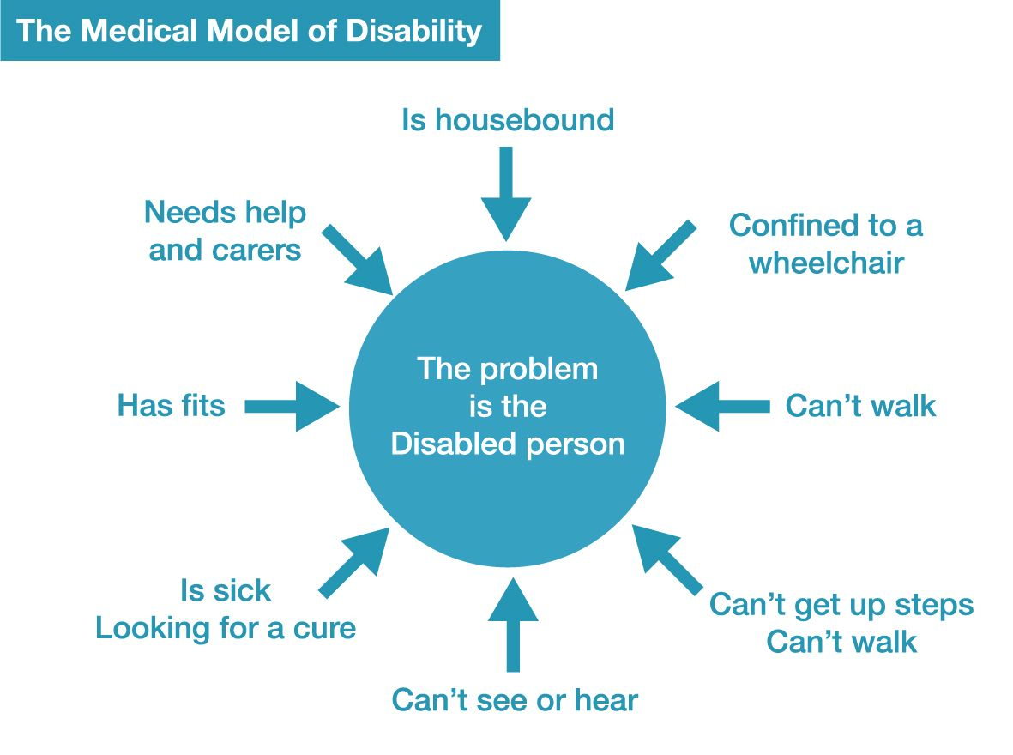
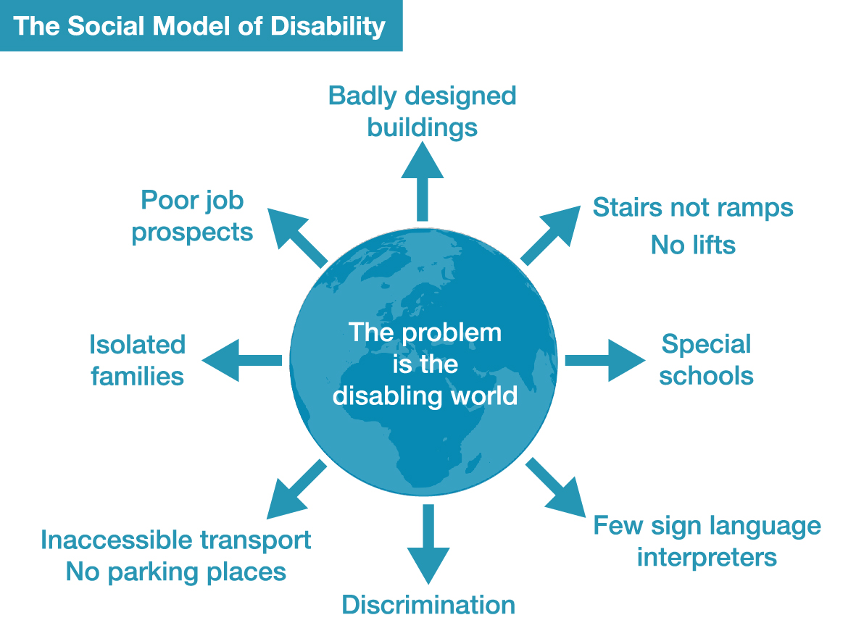
Key tensions to reflect on
vs
A medical model seeks diagnosis & treatment
A social model seeks to remove the barriers that
prevent full engagement in society
Source: InclusionLondon.org.uk

Slide 6
Key tensions to reflect on
My child/this child vs all children
i. Both the LMCS & the Statutory DCS have duties to all children
ii. Both the LMCS & DCS have to balance the needs of individual children within the context of all children

Slide 7
Some common challenges at a system level in SEND
SEND covers a broad spectrum of needs from birth to 25 years of age.
There are many professionals and agencies involved and often they are not joined up around cohorts of need – these are defined in the Code of Practice as (1) Communication & interaction, (2) Cognition & learning, (3) Social, emotional & mental health, and (4) Sensory &/or physical needs.
Often there is no clear view or consensus about what will help.
Inclusion or specialist provision?
Current behaviors/practice direct demand to specialist support – impacting spend allocations.
Opportunities for effective early intervention are missed across the system.
Parents & professionals do not have confidence in the local offer.

Slide 8
Education, Health and Care Plans (EHCPs)
From 2018-2022, there was a 66% increase in EHCP’s:
Source: The United Kingdom Statistics Authority, 2022

Slide 9
Total Dedicated Schools Grant Allocation (£ millions)
On a per-pupil basis the total funding allocated to schools for 5-16 year old pupils, in 2023-24 was £7,460, a 44% increase compared to £5,180 allocated in 2010-11.
Source: Education and Skills Funding Agency, 2022

Slide 10
Headline Figures
More than 80% of children in care in England during the ages of 5-16 also received help for SEN. (i)
The employment rate for people with a learning disability fell to 4.8% in 2021-22. (ii)
The percentage of pupils in England with SEN support eligible for free school meals in 2019/20 was 29.9%, nearly double that for pupils with no SEN (14.9%). (iii)
In 2019-20, 18% of UK undergraduate students said that they had a disability of some kind. (iv)
68% of LA Principal Educational Psychologists (EP) said they had at least one vacancy for a permanent EP post in 2018. (v)
Jay, M; Gilbert, R; (2020) Special educational needs, social care and health. Archives of Disease in Childhood
Base (2022) Employment Rates for People with Disabilities 2021-22.
Gov.uk (2020) Special educational needs in England, Academic Year 2021/22
HESA (2022) Who’s Studying in HE
DfE (2019) Research on the Educational Psychologist Workforce

Slide 11
Area SEND Inspection – new regime, new standards - Ofsted & CQC
First inspections – commenced in January 2023 (Cornwall, Nottinghamshire & Warrington).
Will consider services and impact for all children & young people 0-25 years covered by SEND Code of Practice within a LA footprint.
4 Elements – Full Inspections, Monitoring Inspections, Engagement Meetings, SEND Thematic Visits.
3 Graded Outcomes – Local area partnerships SEND arrangements:
Typically lead to positive experiences and outcomes.
Lead to inconsistent experiences and outcomes.
There are widespread and/or systemic failings leading to significant concerns about the experiences and outcomes.

Slide 12
Area SEND Inspection – Inspector Evaluation Criteria
Local Area Partnership Working
Inspectors will evaluate the extent to which:
leaders are ambitious for children and young people with SEND
leaders actively engage and work with children, young people and families
leaders have an accurate, shared understanding of the needs of children and young people in their local area
leaders commission services and provision to meet the needs and aspirations of children and young people, including commissioning arrangements for children and young people in alternative provision
leaders evaluate services and make improvements
leaders create an environment in which effective practice and multi-agency working can flourish
Experience and Outcomes of Children & Young People with SEND
Inspectors will evaluate the extent to which:
children and young people’s needs are identified accurately and assessed in a timely and effective way
children, young people and their families participate in decision-making about their individual plans and support
children and young people receive the right help at the right time
children and young people are well prepared for their next steps, and achieve strong outcomes
children and young people are valued, visible and included in their communities

Slide 13
Other things are changing too: Regional DfE, Schools White paper, Home to School Transport & CSC reforms
Schools White Paper – now gone. But...leaves some gaps as unclear where proposals are going e.g. Elected Home Education Register, work around behavior and attendance, expectations of a school week – hours of teaching/contact time. New attendance duties for LA’s but no money for new duties & limited leverage.
Home to School Transport – new statutory guidance coming & may not align well with SEND/AP Green Paper.
Regional Schools Commissioners gone – replaced with Regional Directors with broader roles, more staff and more intervention opportunities including SEND.
Children’s Social Care Review – commits to Law Commission Review to simplify & streamline legislation around children with disabilities.

Slide 14
Changes in Health
Health and Care Act – April 2022. Wide ranging and complex
Many about NHS internal organisation & form e.g., NHSE Commissioning Board
& CCG’s have gone.
Establishment of Integrated Care Systems – these have 2 statutory components:
Integrated Care Boards including executive lead roles
Integrated Care Partnerships
Note these are only coterminous in 6 LAs in England.
ICB’s will take on the commissioning functions of CCG’s & accountable to NHS
for expenditure and performance.
Place based leadership is expected with place-based outcomes –
guidance on pooled budgets due Spring 23.

Slide 15
It’s a busy space: Other developments and initiatives
Safety Valve – focused on LA’s where there is the highest deficits in high needs block. 20 LAs initially now expanded.
DBVS – Delivering Better Value SEND – program led by Newton Europe & CIPFA – 55 LAs covered in 3 waves & tranches. Focus on short term help & identifying sustainable changes. Moving into Wave 2.
Council for Disabled Children.
RISE Partnership – looking at What Works in SEND & an Effective Quality Assurance framework.
NASEN – school & FE facing – school led action research, school peer reviews, cultural change in schools.
Early Years SEND partnership.
National Parent Carer Forum – supporting the development of strong local PCF’s.
National Development Team For Inclusion (NDTi) – supporting training to LAs about employment forums and supported internships.
LGA Offer, plus DfE funding for 2 SEND Children’s Improvement Advisors.

Slide 16
The key elements of a good SEND system
A local vision with clear shared values and outcomes focused goals– created & owned by the local system including system leaders.
Clear governance structure – to hold partners together and to drive change.
Partners know their responsibilities and fully contribute to the local system.
Co-production with parents, carers, children and young people – in day-to-day case work and strategically shaping the system
Active, engaged, and valued Parent Carer Forum.
All schools engaged, including active work with Governors and low exclusions.
In the Local Authority- high on corporate agenda, adults & children work together on transitions to adulthood.
Dashboard of KPI’s – know how you are doing.

Slide 17
What should LMCS be asking/thinking about?
What local area partnerships do you have in place for SEND? Are you clear about its governance and does it affect/achieve outcomes for children with SEND?
Do you have a clear vision for children and young people with SEND? Is it up to date? Has it been shaped by young people, their parents and carers? Is there an up-to-date area self-evaluation that has been co-produced?
How do children, young people, and families have their voices heard and shape day to day work and the strategic work in your LA?
How is your Integrated Care Board & Integrated Care Partnership exercising their duties and responsibilities to children and young people with SEND? Is this visible to you? Are they engaged well with your local area partnership?
How do you know what impact your area arrangements are having for children and young people with SEND ?
How are you influencing and levering support within the Council?

Slide 18
What should LMCS be asking/thinking about. (continued)
Do you have a suite of KPI’s so you can monitor performance and hold people to account?
Do you know the quality of your Local Offer and what children and families are saying about this?
What early help support does your local system provide for parents of children with emerging SEND needs or with EHCP’s?
How inclusive are your schools? How many children with EHCP’s attend mainstream schools in your area? How many children with SEND needs are excluded from schools or on shortened timetables & is there a pattern?
What % of children with EHCP’s transition to adult services? Is there good planning in place and smooth transfer?
What % of children with EHCP’s go onto HE, FE or employment ? Are you being ambitious enough?

Slide 19
Thank you
Any questions or reflections?

Slide 20
Green Paper – SEND & Alternative Provision
Identified 3 key challenges:
Navigating SEND & AP is not a positive experience for too many children and families
Outcomes for children with SEND or in AP consistently worse than their peers across every measure
Despite continuing and unprecedented investment, the system is not financially sustainable

Slide 21
Green Paper – SEND & Alternative Provision: Next steps
An Improvement Plan was published in March 2023 outlining how improvements will be delivered.
Already in place:
an increase in High Needs Budget
£2.6 billion to deliver new specialist places
£10 million in 2023 to train 200 Educational Psychologist. Plus £21 million to train 400 EPs from 2024
Proposals – new national SEND standards, new local SEND partnerships, standardisation of EHCPs, digitalisation of EHCP’s, strengthen earlier redress & introduce mandatory mediation, a new SENCO qualification, greater clarity of roles & responsibilities, strengthen accountabilities including health and MATs.
A national SEND Implementation Board.

