Slide 1
Special Guardianship South East Regional Conference
30 November 2021

Slide 2
Introduction
Dr Mac Heath, DCS Milton Keynes and chair of ASGLB

Slide 3
Special Guardianship: more children, increasing focus
Lucy Peake
Chief Executive
lucy.peake@kinship.org.uk
@drlucypeake
Special Guardianship: more children, increasing focus
Lucy Peake
Chief Executive
lucy.peake@kinship.org.uk
@drlucypeake

Slide 4
Special guardianship is rising More children leaving care on a Special Guardianship Order than Adoption Order for third consecutive year SGOs 2021 3,800 (up 2%) 2020 3,700 2019 3,870
Adoption Orders
2021 2,870 (down 18%)
2020 3,440
2019 3,590
Notes:
The most recent data from the Department of Education sets out the fall in the number of children leaving care through Adoption Orders and the rise in the number of children leaving care through a Special Guardianship Order.
DfE has done deep dive to understand fall in adoption numbers. Not framed as it’s a bad thing. They recognise numbers of children in SGO increasing and need to understand more about outcomes.
Longitudinal study outcomes for adoption and SG – feasibility study awarded to Ecorys, Rees and Ipsos Mori.

Slide 5
About the children and special guardians
88% of Special Guardianship Orders were made to kinship carers
10% were made to child’s former foster carers
Child’s average age at SGO 6 years 1 month
73% of SGOs were made due to abuse and neglect, 15% family dysfunction
83% of children were white, 9% mixed ethnicity, 4% were black
Even split between male and female children
Average time in care prior to SGO - 1 year 8 months
64% of the foster carers caring for the children before the SGO granted were kinship foster carers. 24% of children were in stranger foster care
310 children returned to care from an SGO - down from 350 the previous year
(DfE data for the year ending 31 March 2021)
Notes:
No government statistics are available to provide a more detailed profile of special guardians including by type of relative, their ethnicity and age. This is a significant gap in our information.

Slide 6
Growing body of kinship care research - high levels of needs of children and their carers Kinship Care: State of the Nation Survey 2021– 1,651 responses. High rates of permanency 96% of the carers believe the children will live with them permanently 81% are planning to care for them into adulthood Only 2% said they didn’t expect the children to be living with them after the age of 18.
Notes:
Good news – high rates of permanency and commitment to care for children as long as they need it

Slide 7
Kinship children have complex needs Kinship carers are more vulnerable
62% have long-term physical and mental health needs
Of those with formal diagnosis, 40% had anxiety or depression, 38% behavioural issues, 38% attachment disorder
36% children in kinship care - 3x national average - have special educational needs
As a group, kinship carers are older, poorer and in worse health than any other raising children
Survey found 39% kinship carers have additional needs of their own
Notes:
But children have high unmet needs, and kinship carers more vulnerable than others raising children
62% kinship carers believe their children have long-term physical and mental health needs
Only 33% have received a formal diagnosis
Of those with a formal diagnosis, 40% had anxiety or depression, 38% behavioural issues, 38% attachment disorder
36% children in kinship care - 3x national average - have special educational needs

Slide 8
Kinship carers aren’t getting the support they need 30% kinship carers say their children aren’t getting the support they need 36% not getting a financial allowance from local authority 12% had used a food bank in last year 70% said they’re not getting support they need from local authority (but…signs of improvement from 82% last year) 26% had experienced child on carer violence 11% are getting support with contact and family relationships; 23% want support but don’t get it.
Notes:
High needs of children and carers - but not enough support
Signs that local authority support is improving – shocking that 70% kinship carers still not getting the support they need, but an improvement on previous year when 82% felt unsupported. This could be due to Covid-19 funding which enabled expansion of local authority support services. Our sample is also more likely to include kinship carers who do get support.

Slide 9
Adoption Support Fund ASF open to some children with SGOs since 2016 2021 – 15% applications to ASF for children on SGO things are improving slowly… 2019 – 9.4% approved applications to ASF were for children on SGO (3,619 applications, average funding of £3,033) changes to the ASF during the pandemic had a positive impact ASF Covid-19 scheme - one-third of the 23,000 families supported were those raising children under SGO
Notes:
Since 2016 special guardians with a child previously looked after have been eligible to apply to the ASF through the local authority responsible for providing support services.
The Covid-19 ASF Scheme was set up during the pandemic to provide extra funding to local authorities and regional adoption agencies to commission a broader scope of support services, such as access to information and advice and peer-to-peer support for adoptive parents and special guardians whose children were previously looked after, in addition to the therapeutic support provided by the core ASF.
Kinship also supports points highlighted in the Review:
‘Top slicing’ of the core ASF for block commissioned early targeted help for SGO families, as this can be more efficient and effective than spot purchasing, benefiting special guardians who are more likely to access support.
Support directed towards adoptive parents and SGO carers rather than always direct to the child can be important to generate the right environment for children to thrive
Agencies recognising the value of more preventative forms of support for families, particularly peer support and advice and information
Developing a regional core offer, which would be particularly relevant for special guardian families where there is much disparity in support between local authorities
The government has committed to the ASF, which has been consistently under review since its conception, until 2022. Kinship is calling for further reform to better serve the needs of kinship families and recommends:
Funding must be accessible to all special guardians and other kinship families based on their unique needs (only 10-15% of applications are made for special guardians and only for those whose children were previously looked after, which does not reflect the proportion of children on SGO vs AO).
The fund should be renamed to better reflect those entitled, and should be more widely promoted to relevant parties
The scope of the ASF should include services that support special guardian families to address their basic needs through one-to-one support e.g. securing housing, to enable them to then access therapeutic interventions, such as complex behaviour-based interventions, when the time is right
There is a need for a robust monitoring and evaluation programme to measure the impact of support provided by the fund

Slide 10
Pupil Premium Plus uptake
 | 2015-16 | 2016-17 | 2017-18 | 2018-19 | 2019-20
Adoptions Primary | 74.2% | 80.5% | 81.9% | 82.4% | 83.5%
Adoptions Secondary | 34.0% | 43.4% | 48.2% | 51.8% | 55.8%
SGO Primary | 56.3% | 61.4% | 68.9% | 74.1% | 80.8%
SGO Secondary | 32.5% | 34.0% | 37.7% | 40.5% | 49.2%
CAO Primary | 34.3% | 38.5% | 48.3% | 54.8% | 60.2%
CAO Secondary | 25.1% | 23.5% | 24.4% | 25.1% | 26.5%
.
Notes:
DfE has recently revised guidance on the effective use and accountability of pupil premium. This guidance states that a school’s designated teacher should encourage parents and guardians to be involved in deciding how pupil premium plus is used to support their child, and should be the main contact for queries about its use.
DfE statistics suggest there is more to do to increase take up of pupil premium plus for previously looked-after children.

Slide 11
Practising in kinship care: the perspectives of social workers (Joan Hunt, 2021) 1. Recognise and reflect the uniqueness of kinship care within the child welfare system. 2. Recognise and reflect the similarities in the experiences and needs of children requiring any form of substitute care – whatever the legal status of the arrangement. 3. Base support on the needs of kinship carers and their children, not by legal status. 4. Work towards greater consistency in the provision of special guardianship support across local authorities; mapping and evaluating different service models. 5. Develop preparation, ‘training’ and peer support groups for kinship carers. 6. Support kinship families to establish and maintain children’s contact with parents, unless this is demonstrably not in their best interests. 7. Recognise and reflect the complexity of kinship carer assessments. 8. Develop and share professional expertise.
Notes:
New report by Prof Joan Hunt Practising in kinship care: the perspectives of social workers. Is based on the views and experiences of social work practitioners specialising in kinship care and has important implications for policy and practice.
Practitioners spoke extensively about the complexity of kinship care and the challenges of working with families and within systems which are not adequately attuned to the unique characteristics and needs of kinship families.
The report calls for kinship care to be recognised as an entity, a unique form of care requiring policies, systems and practices tailored to its needs. It recommends an end to the ‘square peg in a round hole’ approach of adding kinship care to policies, systems and services that were developed for fostering or adoption.
Forty-two practitioners from 19 local authorities in England and six in Wales took part in the research. Most were either part of a specialist kinship team or had been so in the recent past in their local authorities. Many were part of the long-running Kinship Care Professionals’ Group.
Important implications for policy and practice
The report highlights areas of improvement in kinship care policies and practices based on the insights of social work practitioners. According to the professionals in the sector, there is a need to:
Recognise and reflect the uniqueness of kinship care within the child welfare system.
Achieve institutional recognition of the unique circumstances of kinship families and a commitment to support them.
Recognise and reflect the similarities in the experiences and needs of children requiring any form of substitute care – whatever the legal status of the arrangement.
Widen the policy and research focus on special guardianship to encompass all kinship care arrangements. Support should be based on the needs of kinship carers and their children, not by legal status.
Work towards greater consistency in the provision of special guardianship support across local authorities; mapping and evaluating different service models.
Develop preparation, ‘training’ and peer support groups for kinship carers.
Support kinship families to establish and maintain children’s contact with their parents, unless this is demonstrably not in their best interests.
Recognise and reflect the complexity of kinship carer assessments:
Allow sufficient time to complete kinship assessments
Reaching a shared understanding between local authorities and the courts about what is required in a permanent kinship placement
Develop a standard approach to untested placements
Review the assessment and approval of kinship foster carers
Develop and share professional expertise.

Slide 12
Increasing focus on improving support for special guardians [cover here]
Notes:
The Local Govt and Social Care Ombudsman has called on Councils to provide the right support and guidance to carers and children subject to Special Guardianship Orders.
The Ombudsman’s report, ‘Firm Foundations’ highlights the variety of problems faced by special guardians. It upholds seven out of 10 complaints.
Common faults include councils not giving the right advice, including about the financial support available, before people become special guardians – leaving them to make uninformed decisions about the long-term implications.
Sometimes children who need the protection of a SGO have additional needs, and the Ombudsman is also seeing problems with councils not getting proper support plans in place, leaving guardians unclear about the support available, and for how long after they become guardians.
Other problems the Ombudsman sees include councils incorrectly calculating, changing or cutting special guardianship allowances. In one case, a council wrongly calculated the allowance it paid to scores of families over a number of years.
Public Law Working Group recommendations
1. Legal Aid for special guardians
4 recommendations for immediate change are:
more robust and more comprehensive special guardianship assessments and special guardianship support plans, including a renewed emphasis on (1) the child-special guardian relationship, (2) special guardians caring for children on an interim basis pre-final decision and (3) the provision of support services;
better preparation and training for special guardians;
reduction in the use of supervision orders with special guardianship orders;
renewed emphasis on parental contact
MoJ – Legal Aid should be available for SGs

Slide 13
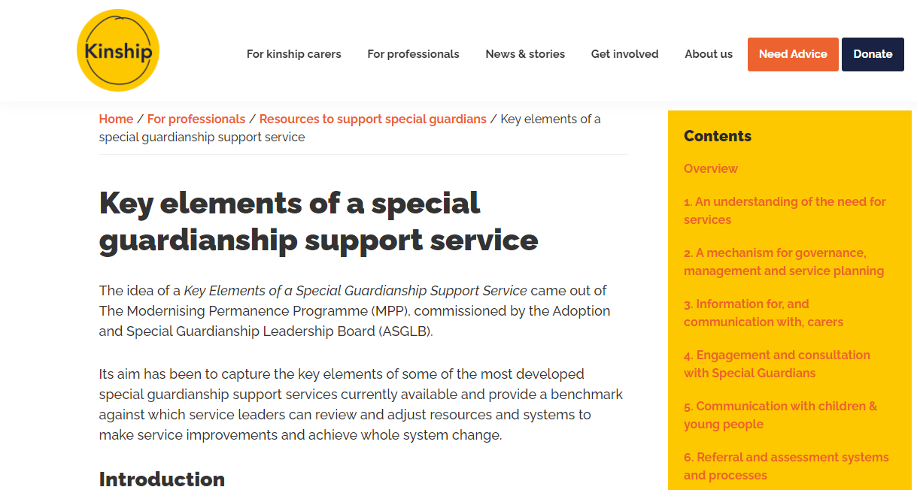
Adoption & Special Guardianship Leadership Board Special Guardian Reference Group – commitment to lived experience Special Guardianship Task Group – initial focus on financial allowances, PP+ and ASF

Slide 14
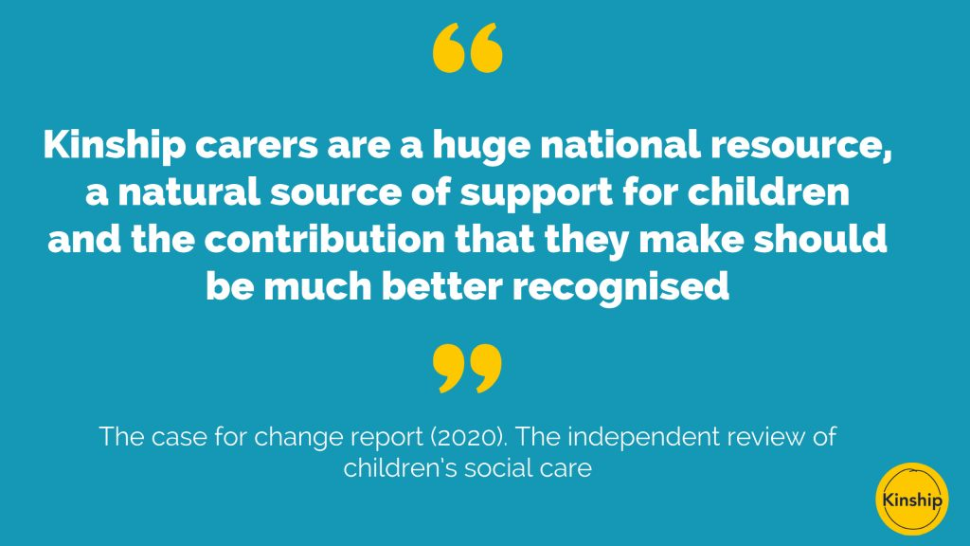
Increasing focus on kinship care – the Care Review
Notes:
Case for Change
Call for Ideas
Expect greater focus on children’s outcomes – outcomes generally better for children in kinship care than foster care.
Dfe has also commission a scoping study to look at long term outcomes for children adopted and in SG arrangements.
Care Review report on costs of foster care – short and long term last week.
Expect greater focus on kinship care as a positive option for children whose parents are unable to care for them.

Slide 15
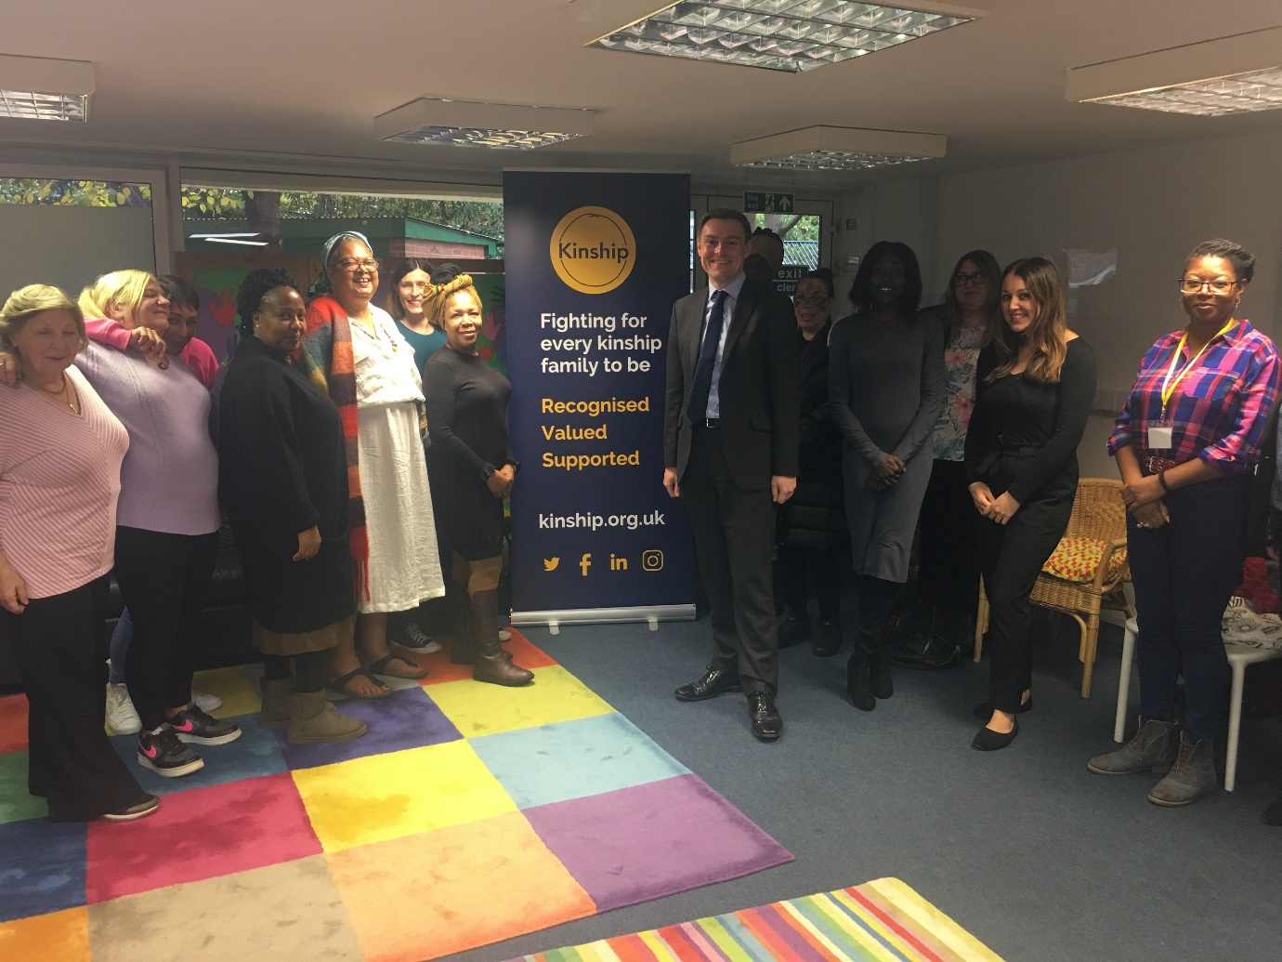
Increasing investment in kinship care support?
Notes:
£1million investment in peer-to-peer support service – a step in the right direction
National infrastructure to support expansion and development of local peer support groups, online peer support

Slide 16
Find out more about our support and services
www.kinship.org.uk
www.kinship.org.uk/for-professionals
www.kinship.org.uk/for-kinship-carers/advice-and-support/
Notes:
Professionals network
Advice and info and community for carers
Evidence informed programmes

Slide 17
Lisa Apps
Practice Manager
Family and Friends & FGC Team
Donna Rainsley
Special Guardian
East Sussex

Slide 18
Overview
East Sussex Family and Friends team
- team of 6 Social Workers, the equivalent to 3.5 full time posts, and one full time Caseworker.
The main role of the Social Workers in the team is to undertake Family and Friends assessments.
The main role of the Caseworker is to offer 6-month post SGO support to kinship carers and undertake ASF applications.
East Sussex are currently financially supporting 323 kinship carers.

Slide 19
Outline
Core themes
Engagement.
Placement support.
Therapeutic support.
Donna’s perspective
Where we were
Where we are
Where we want to be
Notes:
Im not sure what I am saying here?

Slide 20
Engagement - where we were
Initially we had very little support for carers once SGO had been granted for kinship carers.
Once a child arrangement order or special guardianship order had been granted, carers were required to come back through the front door if they required advice, applications for ASF or signposting to services.
Donnas Perspective:
Little engagement post order granted.
Feeling “lost” with no named contact.
“Fight” to even talk to the right person.
No chance to talk or be vulnerable.
This Photo by Unknown Author is licensed under CC BY-NC-ND

Slide 21
Engagement - where we are
Mailing list
To date we have 240 carers signed up to the mailing list.
Survey
Increase in support and training opportunities to support them as kinship carers.
Therapeutic support for their children.
Having a single point of contact for advice.
Support and guidance around contact.
Notes:
Due to being a small team we have targeted our support services.
We initially started by creating an electronic mailing list for carers to opt into.
The mailing list enables us to send out information on a large scale.
We use the mailing list to send out information to kinship carers on support groups, resources, training and events in East Sussex.
Once the mailing list was up and running, we created a survey monkey to ask carers how they thought we could improve our service.
East Sussex is committed in supporting kinship carers and we felt it was important that carers had a voice in where we should target support.

Slide 22
Engagement - where we are now
Kinship carers now have a single person to contact for advice within the Family and Friends team. The Caseworker completes all ASF applications for kinship families.
Written on every support plan is the telephone number and email of the family and friends team.
We have supported carers to establish 5 support groups across East Sussex. They run on a monthly basis and are advertised through our mailing list.
Donnas Perspective
Consulted – surveys.
LA rep @ kinship celebration day.
Support from Kinship – i.e. WhatsApp groups / virtual support groups.
“Bridge” with kinship and LA.
Notes:
The support plan is an important document for the carer and having the details of who you need to contact stops carers being pushed around the system trying to find someone who can assist. The support groups are run by the carers but we have helped with the practicalities such as venues, tea coffee and biscuits.

Slide 23
Placement / Early Support - where we were
Limited support.
Resources not directed.
Limited specialism / training opportunities.
Donnas perspective:
What now?
Little communication.
Different social workers.
“Retelling story”
Feeling alone.
Lost in a system including education/ benefits/ health etc.

Slide 24
Placement Support - where we are now
At the conclusion of public law proceedings every kinship carer is offered 6 months post support via the Caseworker in the team.
The Caseworker will also work alongside the Locality Social Worker if a placement is at risk of breakdown.
Community resources:
- My Time is a peer-based service supporting the emotional wellbeing of children and young people. They have now set up groups tailored for kinship children.
- Sessions solely for kinship children and their carers including fun in the woods and craft events.
Collaboration with the charity Kinship. Every carer is offered a subscription to kinship and dependent on need some are offered additional one to one support from kinship
Notes:
At the conclusion of public law proceedings every kinship carer is offered 6 months post support via the Caseworker in the team. The Caseworker will also work alongside the locality Social Worker if a placement is at risk of breakdown.
We have used resources in the community who have offered groups tailored to kinship carers and the children placed with them. For example My Time is a peer based service supporting the emotional wellbeing of children and young people. They have now set up groups tailored for kinship children. Another community resource is providing fun in the wood sessions and craft events solely for kinship children and their carers.
We also work in collaboration with the charity Kinship. Every carer is offered a subscription to kinship and a small number are offered additional support by Kinship, dependant on the need of the family.

Slide 25
Placement Support - where we are now
Donna’s perspective:
Named workers.
Charities like Kinship offering a range of support both practical and emotional.
Opportunities to meet other kinship families.
Attendance at knowledge workshops to grow understanding.

Slide 26
Therapeutic Support- where we were
Training for kinship carers was the same as that offered to foster carers Limited “in-house” opportunities.
Limited ASF applications.
Donna’s perspective
No clear understanding of where we could get support.
Limited support to consider children's behaviours.
Felt like there was limited transparency.
Limited understanding that due to the lack of support around practical issues felt that therapeutic interventions got “lost”.
Lack of a whole system understanding.
Notes:
We found that kinship carers did not take up the training offered by fostering since offering more bespoke workshops for kinship carers and children the uptake has been far more positive.

Slide 27
Therapeutic - where we are
We have now developed training within our team solely for kinship carers regardless of whether the order was obtained through private or public law.
Workshops currently being offered-
Caring for kinship children which covers trauma and therapeutic parenting.
Life story.
Kinship providing virtual knowledge sessions.
Donna’s Perspective
Knowing who to ask.
Hearing from other kinship carers.
Notes:
We are currently in the process of developing more training workshops which will cover;
Contact.
The impact of drug and alcohol use.
The impact of domestic abuse.
We also want to develop training at the assessment stage regarding what is means to be a kinship carer. This is still in the initial stages as we are unsure how we will present this: for example a rolling training programme or individually by the assessing Social Worker.

Slide 28
Therapeutic - where we want to be
Continue to engage with carers.
Continue and enhance training opportunities / capacity for team.
Donna’s perspective
Support for all children.
Speedier access to support.
Whole family support.
Post intervention support/ follow up.
Recognition of need for practical support to get ready for other interventions.

Slide 29
Evidence
Applications to ASF for SGO carers prior to having a designated worker for ASF:
2018/19- 26 applications made.
2019/20- 18 applications made.
The Family and Friends team became responsible for ASF applications in April 2020 and to date we have made 52 applications.
Placements
2019/20 there was 16 SGO Breakdowns.
2020/21 there was 17 SGO Breakdowns.
2021 to date, there has been 11 SGO breakdowns.
Notes:
The figures demonstrates that having someone responsible for making the applications for ASF is far more effective, this figure is particularly good given the fact we took over making the applications at the start of a pandemic. It should also be noted that the case worker post only began in June this year so the impact of this in terms of placement breakdowns is still to be evidenced.

Slide 30
Where We Want To Be
Investment in further workshops.
Further investment in preparation training.
Building evidence for reasons to invest.
Continue and grow engagement with carers.
Donna’s perspective:
Respite / “drop in sessions”.
Whole system knowledge of kinship families.
Placement “pack” provided – policies/ procedures.
Post sgo “kit” provided – community support, what to expect, who to ask.
Independent support advice and guidance to grow.
Reviews not just about finances – what about changing needs of children.
Notes:
East Sussex are committed in supporting kinship carers, due to being a small team we have targeted our support and in a very short space of time we are already seeing the benefits to kinship families. We would like to be able to develop our support service but I think we have demonstrated that you can offer support to kinship carers even if you have very little resources or funds.
This has all been possible with the support and dedication of the Family and Friends team, particularly our Caseworker whose enthusiasm and commitment to kinship carers is commendable.
With all of the above, we aim to be able to further develop our support for kinship carers and their children.

Slide 31
Notes:
The why
At a Kinship celebration day in October 2021
12 years ago when Christine stepped in to take on the case of her 3 grandchildren she planted an apple tree. At this event she shared the “fruits of her labour” with other East Sussex kinship families

Slide 32
BHCC Kinship Care Team
Ann Horne, Team Manager, Kinship Care Team

Slide 33
The Team
Specialist Team providing relationship based and trauma informed practice. 9.5 FTE
Assessment of potential carers through to post-order support incl to Kinship FC’s
Located within Fostering, Placements and Permanence Service
Comprehensive Annual Report - provides comparative data year on year
Annual Service Plan

Slide 34
Assessment of Potential Carers
Support and Consultation for IVA’s – IVA Champion Model
So You Want to be a Kinship Carer?
12 week assessment timescale
Preparation and Info for Carers
Robust support offer enables us to articulate risk and vulnerability AND how these can be mitigated against
Strong ethical commitment to ensuring children can be placed within their Kinship network where it is safe to do so

Slide 35
Assessment of Potential Carers
Complete a Kinship Assessment - make recommendation regarding type of Order – CO/SGO/CAO.
KCT SW’s involved in care planning for all children in Kinship placements
Updating assessments – post ‘testing out’ period use SB model
Fostering Panel – training and SG on Panel
Assessments graded Good and Excellent

Slide 36
Post-Order Support – Principles
3/6 months allocated SW support then review
Systemic understanding that family roles and relationships around the child need to shift - requires time and support
Relationship based intervention from their assessing SW
Original SGO SP a meaningful and collaborative assessment of support need that informs future support
Assess/Plan/Review model embedded in all support provided
Assessment of Support Need and Review is focused and proportionate to avoid delay

Slide 37
Post-Order Support - Principles
Open door policy - enables carers to build a relationship with Team
Empowers carers to trust in availability of responsive and varied support offer
Strategic work with other services across City to ensure needs of Kinship families are identified and understood – PiCSSSG
Regular communication with Carers via newsletters/emails and Welcome Pack
Anti-racist planning to ensure support is inclusive and targeted

Slide 38
Post-Order Support - Details
Kinship Care Support Service (KCSS) – carers can self-refer via FDFF throughout a child’s minority
KSCC screens referrals – ASN (likely short term intervention) or Duty Tasks
KCSS staffed by Support Officers with management oversight by AP
Families with safeguarding concerns or significant complexity meet threshold for re-allocation

Slide 39
Post-Order Support - Details
Rolling program of workshops inc – Attachment, Contact, Life Story, TP, Keeping Children Safe, Internet Safety plus VS workshops
Monthly Support Group and second Group in development
Applications made to ASF for Specialist Assessment and Therapy - £212K
Robust Financial Support
Carer Participation Project
Menu of Interventions inc – Contact and Mediation, TP, Life Story and Relationship Based Play

Slide 40
Q& A panel
Moderator: Dr Mac Heath, DCS Milton Keynes and chair of ASGLB
Panel:
Lucy Peake, Chief Exec Kinship
Lisa Apps, Practice Manager, Family and Friends & FGC Team, East Sussex
Donna Rainsley, special guardian for her three grandchildren
Ann Horne, Pod Manager, Kinship Care Team, Brighton and Hove

Slide 41
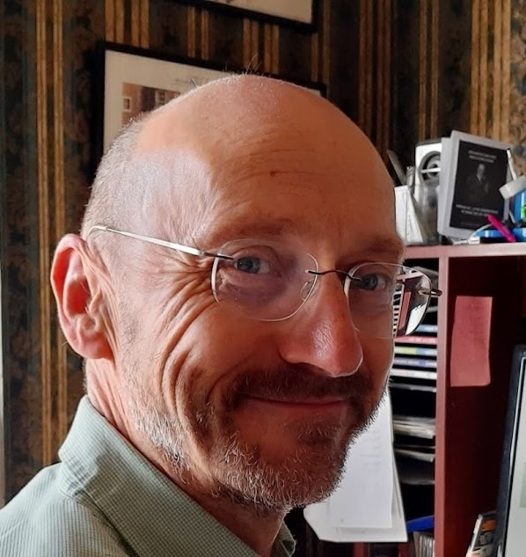
KEY ELEMENTS OF A SPECIAL GUARDIANSHIP SUPPORT SERVICE - based on a survey of exemplar SG support services in England Mike Hall Independent Consultant & Visiting Professor, Chester University

Slide 42
Aims of the project
To develop an outline service specification for an RAA/LA Special Guardian (SG) Support Service based on a review of ‘exemplar’ services currently available in England.
To provide the DfE, Local Authorities (LAs), Regional Adoption Agencies (RAAs) and sector leaders with a benchmark against which they can review and adjust resources and systems to make service improvements and achieve whole system change.
(A similar exercise to develop a service specification for Adoption Support Services has been completed separately)

Slide 43
Exemplar practice examples have been received from…..
Statutory sector - Adopt Thames Valley, ASPIRE Adoption, Brighton and Hove, Bromley, Dudley, Hertfordshire, Kirklees, Leeds, North London Adoption & Fostering Consortium
Voluntary sector – Kindship (Grandparents Plus), Liverpool Kinship Carers, PAC-UK/Family Action
Research - Paul Shuttleworth – Sussex University, Paul McGrath - UEA

Slide 44
The Sections are…..
 | Key Elements of a Special Guardianship Support Service
1. | An understanding of the need for services
2. | A mechanism for governance, management and service planning
3. | Information for, and communication with, carers
4. | Engagement and consultation with Special Guardians
5. | Communication with children & young people
6. | Referral and assessment systems and processes
7. | Preplacement support to Special Guardians and children
8. | Support with contact arrangements and managing family relationships
9. | Financial advice and Support
10. | Preventive/Early Intervention support for families and children’s emotional and psychological well-being
11. | Specialist support for families and children’s emotional and psychological well-being
12. | Services to support the transition of young people to independence
13. | Support to access services from other parts of the Local Authority
14. | Support to accessing services from other agencies
15. | Commissioning systems and processes
16. | Workforce development
17. | Monitoring and evaluation
18. | Birth parent support
19. | Budget and resources
20. | A plan for the future development of services

Slide 45
Each section of the document describes…
Key elements of an SG support service
E.g. Engagement with SGs, access to multi-professional services
Why each element is needed
What is required under statute/guidance
What research tells us
What is the perspective of SGs themselves
A description of exemplar approaches and where to find them
Backed up in the appendices with templates, policies, systems and processes
Comment/Areas for future development

Slide 46
5. | Communication with Children & Young People
 | Why is this needed? To develop the most relevant and effective services it is crucial both to listen to the views of individual children and to gather information from those children and young people who have experience of special guardianship and kinship care.
 | Government/Statutory requirements Schedule to the regulations 103. In all cases it is important to accurately ascertain and report on the child’s wishes and feelings.
 | Research/SGO/Children’s Perspective There is a dearth of evidence on children’s views. The very small number of interviews with children identified some important themes around their understanding of the Order, their life story and nature of their family relationships, and the development of a positive sense of identity. (Nuffield 2019a p10)
 | Children’s Perspectives The majority of children wished their social workers had listened to them more and asked their opinions at the earliest point. However, they acknowledged that this was difficult as some information is difficult to hear. Therefore, they wanted information given to them by people, including possibly family members, that they trusted, in sensitive manner. (Shuttleworth - In preparation)
 | Carers’ perspective SGs consulted as part of this study noted very little direct communication between Social Workers and children subject to SGOs. Children were often not given clear explanations about their circumstances or the implications of an SGO and many children subject to an SGO do not have an allocated Social Worker post order. Any engagement which did take place with children was often negative and focused on safeguarding issues.
 | Examples of approaches currently being taken Kirklees run a programme of support groups and activities for children of different ages. Feedback on these activities has been collated and shared with OFSTED (see appendix three). Kinship Carers Liverpool conducted a sample survey with 32 young people in December 2017, together with a focus group and arts-based family consultation exercise. Very high levels of impact were reported by many young people regarding their use of the service. This was particularly true in relation to the group activities: the Summer Programme, the family days out and the Intergenerational Activities. NLAFC is working with a local group, Body and Soul, to open their services to children. Body and Soul uses a comprehensive, community-based and trauma informed approach to address the life-threatening effects of childhood adversity in people of all ages. They are aiming to produce material directly to capture views and feelings of children. http://www.bodyandsoulcharity.org/
 | Additional considerations There appears to have been very little consultation and engagement with children and young people subject to an SGO……

Slide 47
https://kinship.org.uk/for-professionals/resources-to-support-special-guardians/special-guardianship-support-service-guide/

Slide 48
Exempla Special Guardianship Support Service
Engagement
Clear policy statements
Info on support services
Website signposting to independent advice and information
SG Consultation group(s)
Partnerships with voluntary sector, LAC, CAMHS, Fostering & Education Services
Birth Parents
Group
Preparation Groups
SGO Participation
Information /Communication
Preplacement Support
Strategy and Resources
Support to birth parents
Standard Written Communications
Service Development plan
Outcomes for Children
SGO Assessment Process
Wishes/Needs/Feelings of the child
Workforce development
Budget
SGO Multi-Agency Board
Outcomes for Children
Monitoring and evaluation
Children’s Group
Data Collection,
Protocols with Health/Education/Safeguarding/Housing/CAMHS
Financial Support
Commissioning
Peer to peer Support
CAMHS
SG Support Assessment
One Front door to support services
Psychology consultation
Review of Support Plans
Education support
Specialist Therapeutic Services
Therapeutic parenting Course
Preventative/Early Support
Respite care
Life-Story Work
Contact support
DDP
Transition to independence
NVR
Governance
Coordination, systems & process
Delivery

Slide 49
Further information, discussion & support Each LA can get 0.5 a day support, with more time by arrangement
Mike Hall
mikehallassociates@gmail.com
07981 837 774

Slide 50
Strengths in our LAs

Slide 51
Opportunities that we can address regionally

Slide 52
Feedback from small group discussions One key point that struck you….
There is an artificial transfer point for F&F cases who then go on to become SG. LAs should be clearer what support was available post-SG order support, and 3 years are up
The language we use is inconsistent, continuity would be useful (kinship, SG, connected person)
LAs need to invest in SG practitioners to front load services otherwise we risk higher levels of breakdown and poorer outcomes and greater costs down the line
The increase in SGOs as against adoption as route to permanence is significant
There is a need to update the national means test. It currently doesn’t take into account extra costs associated with looking after children under SG
Practice and need will be variable across Las due to different sized Las, different demographics, but principles set nationally would be helpful
Improving consistency of support must be a key priority going forward
Simply putting contact numbers and emails on support plans so it always easy for SGs to make contact with someone that can help - why did we not think of that?
Protocol agreement between LAs could be useful so the new LA can take forward what is agreed in the SG support plan
Donna’s experience shocked us the whole system needs to be better joined up around Special Guardians - we need to get different services on board quickly – e.g. CAMHS, education, benefits, housing

Slide 53
Feedback from small group discussions Areas where training or practice development may be useful
Finance and support - Training and development of finance and support packages. These are variable in the different LAs. There is a strong need to support for kinship carers on an ongoing basis following conclusion of care proceedings, for example through a named person that rings the SG when order granted, sending SG applicants information including Kinship.org at the start of the process.
Coproduction and voice - Training that will enable us to understand each party’s experience (child, carer, birth parent, professionals)
Contact – some LAs use highly-skilled support workers with mediation skills to deliver contact; contact for SG is different to adoption or fostering and practice needs to be further developed. Our approach to contact also needs to be flexible, as what the court said many years ago might not reflect the child’s needs now.
Better join up – There is a need for more consistency/communication between teams within LAs re: SGO assessment and support as well as with the wider system (education, health, housing, CAMHS, police etc.)

Slide 54
Closing and next steps
Lorna Hunt, Service director PACT and vice chair SE ASGLB
We have secured £15K DfES funding matched by £15K form the SE sector led improvement programme. This is being used to:
support this conference,
Provide 0.5 day support to all LAs to use tools and complete self assessment on their SG practice by Mike Hall
deliver training/practice development in the Spring/Summer to address gaps and priorities identified through this conference and the self assessments
Mike will be in touch with each LA to discuss the tool over December/January or you can contact him directly

