Slide 1
South East regional Kinship Care conference
July 8 2024

Slide 2
Agenda
43 participants from across the South East attended
96% of attendees said they thought the conference was a good use of their time
Item | Presenters
Agenda and housekeeping | Rebecca Eligon (SESLIP)
Welcome | Dr Mac Heath (DCS Milton Keynes and Chair)
Reflections of kinship care | Sarah Crowley (Kinship carer)
National kinship strategy | Lucy Peake (CEO Kinship and deputy chair)
Adoption and special guardianship support fund | Duncan Clark (Mott McDonald)
New responsibilities for virtual school heads re: Kinship | Michelle Nye (Virtual School Head, Hampshire
BREAK
Mapping practice | Rebecca Eligon (SESLIP)
Resetting regional priorities | Rebecca Eligon (SESLIP)

Slide 3
Dr Mac Heath, DCS Milton Keynes and chair of regional kinship group and adoption board

Slide 4
South East Regional Kinship Arrangements
All 19 SE L.A.’s agree to work together in developing support to Kinship arrangements that have coherence, consistency and commitment to mitigate a ‘postcode lottery’ in approach
We have the mandate to understand where the strengths lie, identify the gaps and propose opportunities
8th July 2024

Slide 5
Developing kinship care: a case for evidence based social work practice
‘the very idea of “kinship care‟ remains contested in theory, law and operational practice in local authorities’
‘this research does not seek to evidence best practice in its own right but to recognise the variance of kinship in practice and approach and, from knowledge gained, set out a proposed model of good practice, one that is responsive to the findings and could be adopted within local authorities in England’
‘whatever changes are made at a government level, and whatever local guidance is issued around kinship care, the importance of how this is then enshrined into local authority policies and then manifested in social work practice, is likely to be an area of challenge for a significant time to come’

Slide 6
Lucy Peake, Chief Executive Kinship, and vice chair of South East regional kinship group

Slide 7


Kinship Care Strategy – what’s next?
Lucy Peake
Chief Executive, Kinship
South East Kinship Conference
8 July 2024

Slide 8
About Kinship
Kinship is the leading kinship care charity in England and Wales. We’re here for all kinship carers. We want every kinship family to have the recognition, value and support they need and deserve.
CHANGING LIVES
Developing support for kinship families so they can access high quality information, advice and support wherever they live
Kinship families are at the heart of what we do
CHANGING THE SYSTEM
Building awareness, understanding and recognition about kinship carers’ role in children’s lives. Campaigning for change so kinship care is promoted and supported by legislation, policy and practice.
National information, advice, training & support service
National peer support service
Support programmes with local authorities
Raising awareness & influencing policy & practice

Slide 9


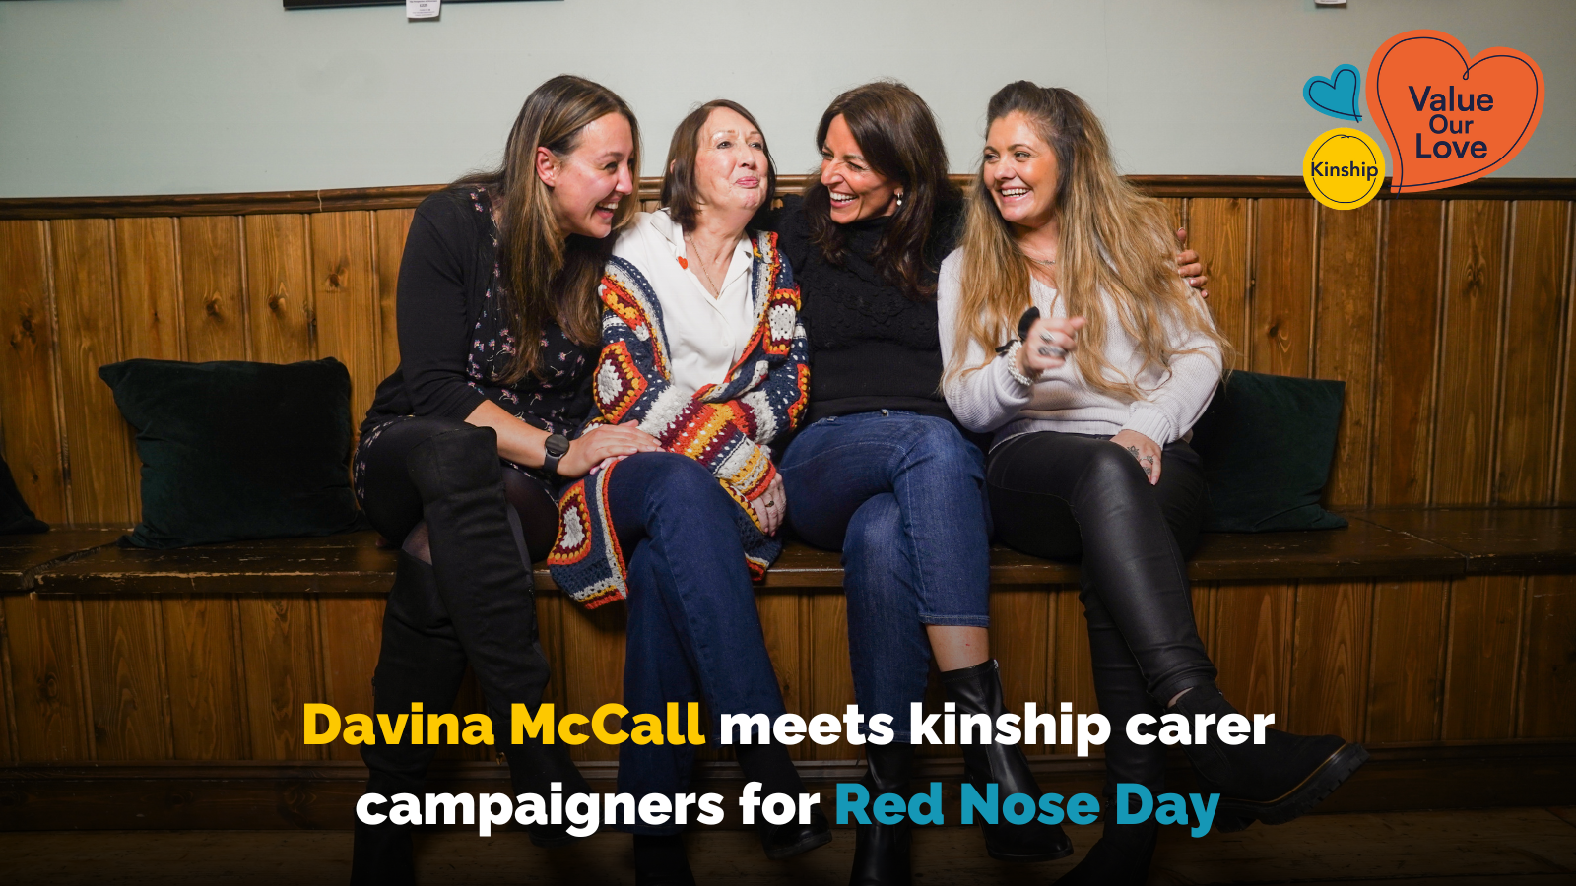

Notes:
In October 2022, Kinship built on more than two decades of campaigning shoulder-to-shoulder with kinship families to launch the #ValueOurLove campaign, pushing on the UK and Welsh Governments to recognise the disparity in support between kinship families and foster and adoptive families, and push for a dedicated kinship care strategy which prioritised the urgent support families need today and build a kinship system fit for the future. Since then, we’ve had enormous success engaging with politicians in Westminster and the Senedd, as well as key sector stakeholders such as the Children’s Commissioner for England, and have brought the views and experiences of kinship carers directly to those in power. We’re also proud to have had considerable support from high-profile celebrities including Davina McCall and Professor Green, both of whom were raised in kinship care by their grandmothers.

Slide 10

Labour commits to supporting kinship families
Labour Party’s manifesto:
“Every child should have a loving, secure home” and committed to supporting children “including through kinship, foster care and adoption.”
Election campaign activity:
6,800 #ValueOurLove emails sent by 1,500 supporters to 2,500 MP candidates in 90% constituencies
190 candidates signed up to the campaign
Cross-party support

Slide 11
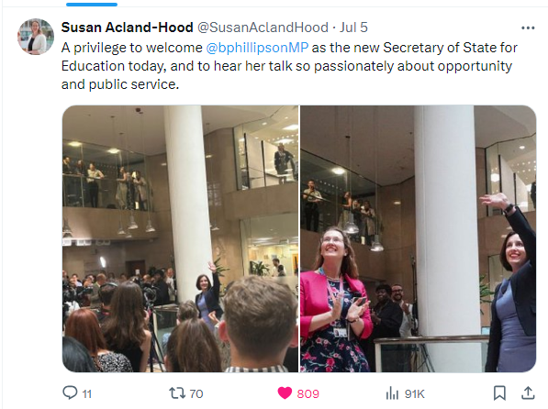
Secretary of State Bridget Phillipson commits to children’s social care reform
“…the greatest mission of this Labour government…will be to break down the barriers of opportunity which hold back too many of our children, which scar the life chances of too many of our young people.…the values that underpin that mission…will be at the heart of our approach as we tackle the issues that you all know well, but that have had rather less attention in recent weeks during the election campaign: the support and outcomes for children with SEND and their families, the need to bring reform to children’s social care and to build opportunities for our most vulnerable children…”

Slide 12
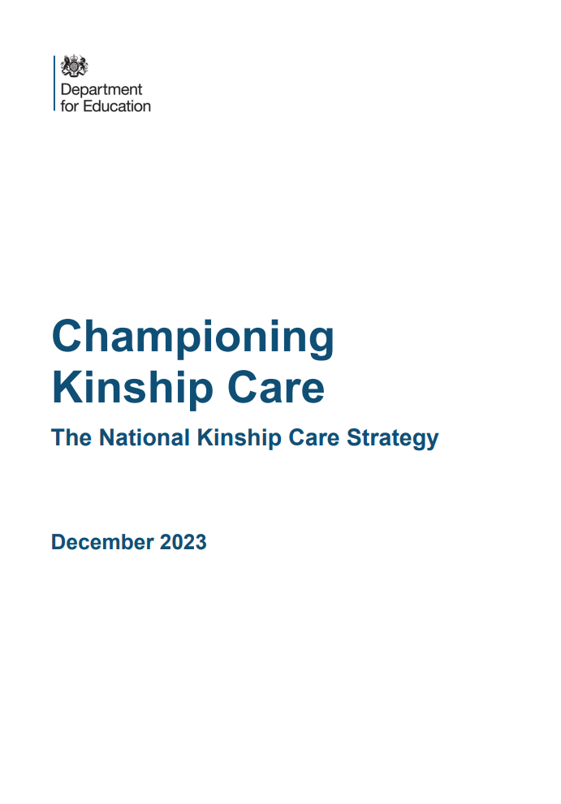




Kinship Care Strategy - Vision
Children will be supported to stay within their families, where possible. Families will receive the right help at the right time to ensure this.
When it is considered that a child is unable to remain living with their parents, family networks will be consulted and have their options explained to them clearly
When a kinship carer is formally assessed, the assessment process will be reasonable, proportionate and treat family members with trust, whilst prioritising the safety of the child
Children in kinship care will be supported to thrive. Kinship families will be actively offered support that is tailored to their needs

Slide 13
Kinship Care Strategy - £20million investment
An SGO allowance ‘Pathfinder’ programme
Guidance for employers on supporting kinship carers
An expansion of the Virtual School Head’s role
Appointing a new “Kinship Care Ambassador”
Establishing a kinship training, information and advice offer
Continuing kinship peer support groups
Improving awareness of the Adoption and Special Guardianship Support Fund
Working towards national roll out of Family Group Conferencing
Introducing a new definition of kinship care
Publishing an updated version of the 2011 Family and Friends Care statutory guidance
Confirming the Law Commission will review legal orders and statuses for kinship carers

Slide 14

Training, information, advice and support
Roadshows –in-person regional events (workshops, peer support, market place)
Portsmouth – Wednesday 18 September
London – Wednesday 15 January
Introduction to kinship care workshops – online
Advanced workshops – online
Peer support – in-person and online (local and specialist)
Advice and information – online, by phone and by email

Slide 15
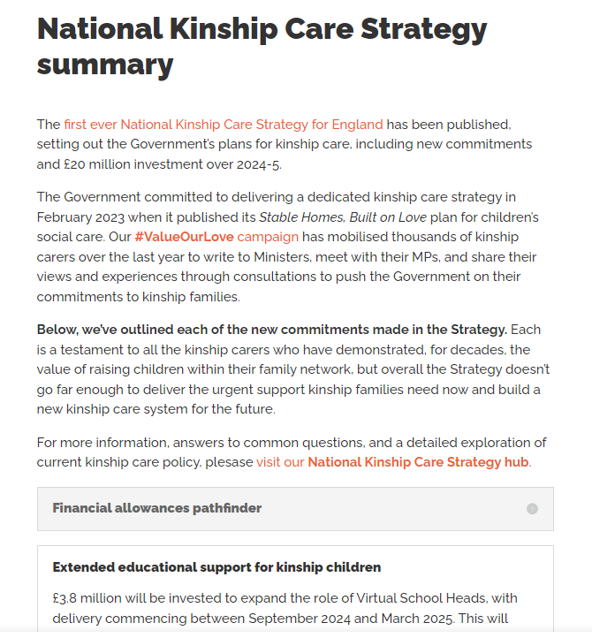
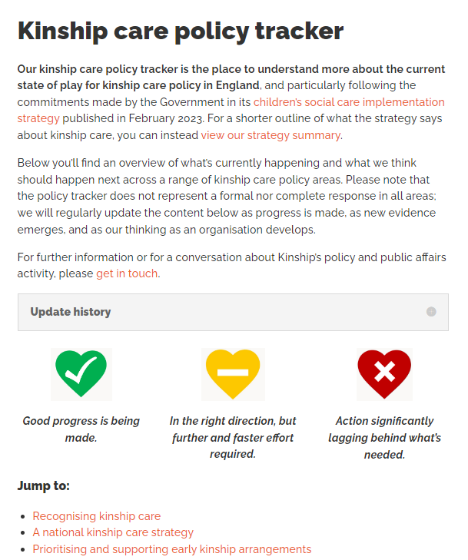
Strategy summary
“I’ve got 3 mins!”
Kinship care policy tracker
“Give me the detail!”
kinship.org.uk/national-kinship-care-strategy/strategy-summary/
kinship.org.uk/kinship-care-policy-tracker
Notes:
There’s much more in the Strategy which I don’t have time to go into today, but thankfully our team have prepared lots of materials for you to explore.
If you want a quick summary of the main Strategy commitments, visit our summary page.
If you want a detailed exploration of kinship care policy in England including an up-to-date overview of what’s happening now, our verdict, and what should happen next, you can check out our regularly-updated kinship care policy tracker.

Slide 16
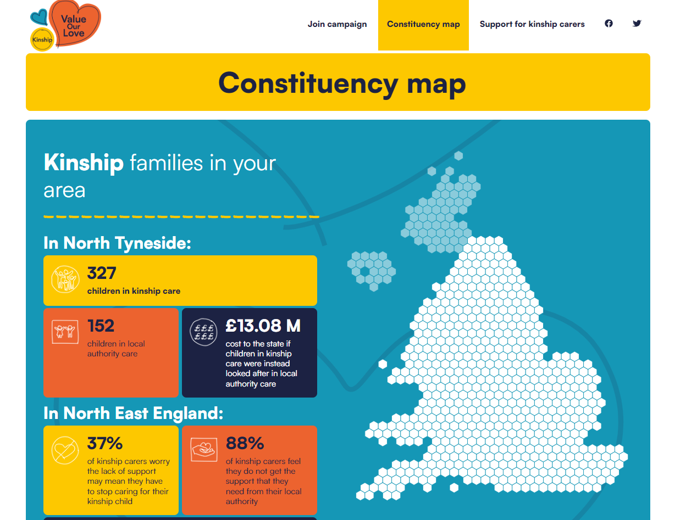
Ask the new Government to support kinship families
Equalise financial allowances between foster and kinship families.
Equalise access to training and support between kinship carers and foster carers.
Equalise leave between adoptive and kinship families.
Equalise support between children in kinship care and those in care.
Sign our petition, write to your MP, and learn more about kinship families in your local area at valueourlove.kinship.org.uk.
Notes:
Our #ValueOurLove campaign is calling for financial allowances on a par with fostering allowances for all kinship carers to recognise how an existing lack of financial support often plunges carers into poverty from often already precarious circumstances. In our last survey, 1 in 10 kinship households said they had run out of food and couldn’t afford to buy more in the last two weeks.
We also want to see better access to training and support which recognises kinship carers’ unique needs, experiences and strengths. We’re proud to have campaigned successfully for the UK Government to invest in this in England, and Kinship will be delivering a national training and support offer for all kinship carers regardless of the type of kinship arrangement.
We want to see a right to statutory leave and pay from work, just as adoptive parents get. Our survey found that more than 8 in 10 kinship carers had to give up work permanently or reduce their hours after taking on the role, pushing many into the benefits system unnecessarily and robbing them of the protected time they need to settle a child into their new home after an often traumatic experience.
And finally, we want to see better support for kinship children including widespread access to Pupil Premium Plus funding and priority admissions in school, as well as tailored mental health and therapeutic support which understands the complexities of kinship care situations and the impact family dynamics have on children’s wellbeing, identity and relationships.
You can help the campaign by joining online and writing to your local MP. We’ll soon be launching our updated kinship care constituency map so you can explore data for your area and learn how to spread the word to prospective parliamentary candidates ahead of the next general election.

Slide 17
Visit our stand and stay in touch
Tom Bucher, Head of Network Development (lead contact for local authorities and virtual schools in the South East)
tom.bucher@kinship.org.uk
Fiona Summers, Head of Programmes (lead contact for commissioned programmes) Fiona.summers@kinship.org.uk
Lucy Peake, CEO lucy.peake@kinship.org.uk

Slide 18

Adoption and Special Guardianship Support Fund
Duncan Clark
July 2024

Slide 19
1
Background to the Adoption and Special Guardianship Support Fund (ASGSF)
2
The ASGSF Journey
Agenda
3
The ASGSF so far
4
How does the ASGSF work?
5
ASGSF Criteria and Eligibility
6
What can & can’t funding be used for?
7
Resources & useful information
Notes:
Sharon

Slide 20
Background to the ASGSF
The Fund has provided much-needed, life-changing therapeutic support since its inception in 2015.
The need for the fund emerged out of recognition of the challenges faced by adoptive families and the resulting trauma requiring comprehensive support.
The fund provides one element of this support and has had a transformative impact for many families; preventing the risk of disruption and providing a consistent support offer for families across England.
The fund is aimed at improving the lives of children and young people both now and into the future.
Notes:
The Adoption & Special Guardianship Support Fund has provided much-needed, life-changing therapeutic support to more than 129,000 recipients. The need for the fund emerged out of recognition of the challenges faced by adoptive families and the resulting trauma needing comprehensive support. The ASGSF provides one element of this support and has had a transformative impact for many families; preventing the risk of disruption and providing a consistent support offer for families across England.
The fund is aimed at improving the lives of children and young people both now and into the future with the Department recently confirming support to up to March 2025.
Children and young people have highlighted the important part ASGSF funding has played in helping them to understand themselves and enabling their parents and special guardians to be better equipped to care for them and gives them the support they need to be able to thrive.

Slide 21
The ASGSF Journey
2013 – Further Action on Adoption
DfE report published setting out proposal to attract adopters and improve support available to adoptive families.
2014 – ASGSF Pilot
The then ‘Adoption Support Fund’ (ASF) was operationalised initially with 10 pilot local authorities.
2015 – National ASGSF
1st May 2015 the ASGSF was opened to all 152 LAs in England.
2016 – Programme Extension
1st April - ASGSF extended to cover children that left care through SGO or ICA.
2016 – Fair Access Limit
6 October saw the introduction of the £5k FAL to manage demand and sustainability of the Fund.
2017 – Fair Access Limit
Existing FAL of £5k continued with a separate £2.5k specialist assessment FAL was launched.
Focus on RAA development
2020 – Emergency Covid-19 funding scheme
£8m was committed to fund immediate therapeutic support arising from the impact of the Covid- pandemic.
2023 – Kinship Care Strategy
To minimise the barriers kinship carers face and ensure more carers are aware of the fund it was renamed to Adoption and Special Guardianship Support Fund (ASGSF).
Notes:
2013 – in January 2013 the DfE published their report Further Action on Adoption: Finding more loving homes, to address the outstanding challenge for the adoption system with finding enough adoptive parents. In March 2012 there were over 4,600 children waiting to be able to move in with a new family. It was identified that adoption support was one of the most important areas for reform. Surveys showed that some parents did not even know about their right to request an assessment of their support needs, and where assessments happened families were too often left without the support that they needed.
2014 – The ASGSF was piloted with 10 authorities, where we provided support with the assessment process and readiness for national funding for adoption support.
2015 – The ASGSF was launched nationally to all 152 LAs in England.
2016 – The criteria was extended to include children who were adopted from other countries via an intercountry adoption and made available to special guardians who care for children who were previously looked after. It was also made available to young people up to the age of 21 without an Education, Health Care Plan.
2016 - In addition, we saw the introduction of the fair access limit of £5k per child each year to manage demand and sustainability of the Fund. The fund has grown every year since its introduction in 2015, with the current budget more than double the original investment of £18m, underlining the Government’s determination to support adoptive and special guardianship families as they settle into their new lives.
2017 – The Department identified that a proportion of the child’s fair access limit was being used for specialist assessments and introduced a separate fair access limit for specialist assessment at £2.5k per child each year.
2020 - In response to the outbreak of coronavirus (Covid-19), in April 2020 the DfE committed up to £8m of the available funding from the ASGSF budget for 2020/21 to implement a temporary emergency Covid-19 funding scheme. The scheme enabled RAAs and LA adoption and special guardian teams to access funding to provide different types of immediate therapeutic support for eligible families whose children may have already suffered trauma, to meet the needs arising from the impact of the pandemic. We were commissioned to manage the process and approved and distributed over £6.5million during this time, which directly supported up to 60,976 families. During Adoption Week the Secretary of State for Education specifically referenced the success of the ASGSF Covid-19 Scheme and the funding that was provided to help adoptive and special guardian families facing greater stress during the pandemic.
2023 – The kinship care strategy was published, aiming to champion, support and empower kinship families. Whilst financial investment alone will not deliver the vision, the announcement confirmed a package of £20 million in 2024-25 to improve the lives of more than 130,000 children who live in kinship care today. The investment will be used to minimise the barriers kinship carers face, so that they can more easily provide stable, loving homes for children.
Championing Kinship Care is the first step towards the long-term vision and one of the aims is to ensure that more eligible kinship carers are aware of their ability to access the Adoption Support Fund, by renaming it to the Adoption and Special Guardianship Support Fund, as well as analysing the fund’s applications and the therapies provided.

Slide 22



The ASGSF so far
Families have accessed the Adoption and Special Guardianship Support Fund (ASGSF) to benefit from a range of therapeutic services.
107,829 Approved Applications
£356 million Funding Approved
Supporting more than
129,000 service recipients
* Figures at 31.01.24
Notes:
Children and young people have highlighted the important part ASGSF funding has played in helping them to understand themselves and enabling their parents and special guardians to be better equipped to care for them and gives them the support they need to be able to thrive.

Slide 23



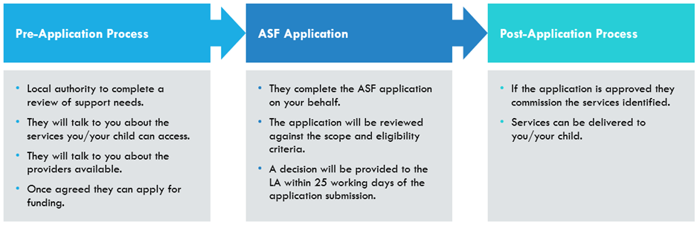
How does the ASGSF work?
Notes:
How can I get help?
You will need to have an assessment of your family’s support needs by a social worker from the children’s services department in your local authority (council).
Where the assessment identifies that the therapeutic services funded by the ASGSF would be beneficial to your family, the local authority will apply to the Fund on your behalf within 3 months of assessing a family’s support needs. The Fund will approve funding to the local authority. The local authority will then use the funding to commission and pay the agreed provider of services.
There is a Fair Access Limit of £5,000 per child for therapy. This is as well as a separate amount of up to £2,500 per child if specialist assessments are needed per financial year. Further information about this can be found here.
The local authority social worker is expected to talk to you about who can provide the types of service that you need and which provider is most suitable.
How does the LA access funding?
Applications are normally successful provided that:
The application confirms that you meet the eligibility criteria
The recommended services have been approved by the local authority to meet national quality and safety standards
The application form has been completed correctly.
Applications are usually processed within 25 working days.
All identifying information about you must be excluded from the application form. This is because it is information that is confidential between you and the local authority.
The Adoption Support Fund notifies the social worker who applied for funding (usually within 25 working days) and the social worker should then let you know the decision. If the application is successful, the Adoption and Special Guardianship Support Fund sends the money to the local authority who pays the provider for the agreed services.
You can then get the service you and your family need. However, it is worth noting that there may be waiting lists for some local services.

Slide 24
ASGSF Criteria and Eligibility
Do you have an SGO or Child Arrangement Order?
Children previously looked after by the local authority can access funding for therapeutic services. Your local authority or regional adoption agency can provide further advice around eligibility and if you meet the criteria, they can complete an application on your behalf.
Notes:
The ASGSF model is based on the existing statutory framework for the assessment of adoption support, SGO or CAO support needs and the provision of support services.
To be eligible for funding, local authorities and RAAs must apply to the ASGSF within 3 months of assessing a family’s support needs, through a therapeutic needs assessment (TNA) which is paid for by the LA.
The ASGSF is available for children and young people up to and including the age of 21, or 25 with an education, health and care plan, who:
looked after by the local authority before a SGO was made;
looked after by the local authority before the SGO was made but subsequently changed to an adoption order, or vice versa;
looked after by the local authority prior to living under a child arrangement order (CAO) to enable the assessment of a potential special guardian. They remain eligible if an SGO is subsequently made .
Comprehensive online information for special guardians has been published by the Family Rights Group

Slide 25
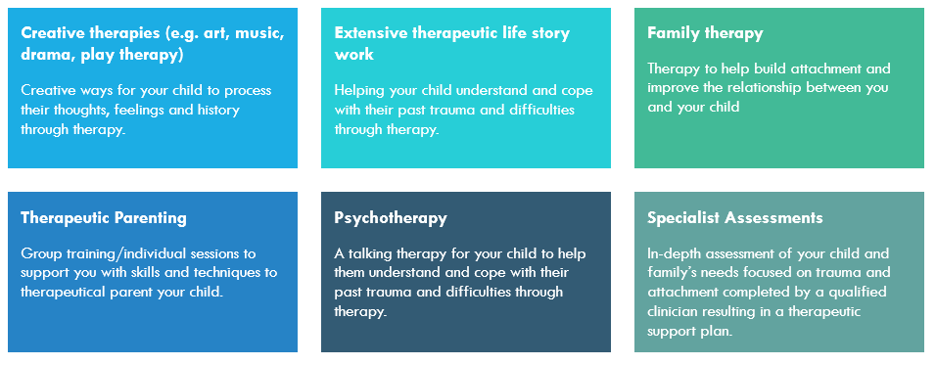
What can the funding be used for?
Notes:
The scope and criteria of the fund has been determined by the Department for Education. It was originally developed in conjunction with a panel of subject matter experts who made recommendations on the therapies and assessments which form the foundations of the scope of the fund. Services which are in scope can be found on www.first4adoption.org.uk/ and Family Rights Group (frg.org.uk) websites, but please note that this is not an extensive list, and if further information is needed on the scope of the fund, we would suggest getting in touch with your LA/RAA.
The below give a high-level list of the types of therapies that are in scope of the fund:
-Creative therapies - enable expression through a variety of ways, often without using words, such as through painting, drawing, dance, music or drama.
-Extensive therapeutic life story work - offers children the opportunity to explore, question and understand past events of their life. Within this, it gives them a voice and safe space to feel and express their emotions when making sense of past experiences and the relation it has to their current thoughts, feelings and behaviours.
-Family therapy – a form of talking therapy focusing on improving relationships among family members, managing conflicts within the family system, and addressing behavioural issues to help build attachment.
-Therapeutic parenting - aims to provide nurturing care and support for children who have experienced trauma providing you as parents with the skills and techniques to building strong, secure attachments with your child and navigate challenges. Evidence-based parenting courses have been adapted to meet the needs of Adopters or Special Guardians which specifically focus on trauma.
-Psychotherapy – a form of talking therapy, examples include Dyadic Developmental Psychotherapy (DDP) which is a treatment developed to deepen the emotional connections in our relationships with others. Another example is eye movement desensitisation and reprocessing therapy (EMDR) which stimulates the brain to reduce the intensity of distressing memories. Another example is Non-Violent Resistance (NVR) which is a psychological approach for overcoming destructive, aggressive, controlling and risk-taking behaviour.
-Specialist Assessments – must meet all of the following three criteria in order to be funded by ASGSF:
1)An in-depth assessment of the child and family’s needs with a focus on trauma and attachment, and how this demonstrates the links to the assessment of support needs.
2)Led and undertaken by a qualified clinician(s). For the purposes of the ASGSF, a qualified clinician would be someone who diagnoses and treats patients; is suitably qualified and is licensed to practice via a regulator such as the Health and Care Professional Council e.g. a trained Clinical Psychologist or Attachment Psychotherapist.
3)Result in a therapeutic support plan for the child(ren) and your family.
Please be aware that each individual application is reviewed in its own right, and we reserve the right to query any information within the application submitted by your LA if unclear or further clarification is needed in order to process the application.

Slide 26
What can the funding not be used for?
Standalone assessments for single conditions
Unless part of a wider Specialist Assessment.
General social work assessment of SGO support needs
This remains the responsibility of the local authority.
Support offers from your LA
This include the universal health services and short breaks with no therapeutic focus.
Memberships
Of clubs and organisations.
Education support
This can be funded through alternate funding streams such as Pupil Premium Plus
Therapies with no trauma and attachment focus
Reviewed by the expert panel as out of scope.
Notes:
The following are not in scope of the Fund:
Standalone assessments for single conditions, e.g. ADHD, FASD, autism, sensory integration, unless they are part of a wider specialist assessment which meets the criteria for the Specialist Assessment FAL as mentioned on the previous slide i.e. are in depth, covering trauma and attachment, led and undertaken by a qualified clinician and resulting in a therapeutic support plan.
Therapeutic needs assessment - a general social work assessment of SGO support needs remains the responsibility of the local authority/regional adoption agency and should be completed prior to an application being made to the ASGSF.
Local Authorities should already be providing the following under their adoption support services:
Information, advice, guidance and signposting
Counselling
Opportunities for adoptive parents to interact (e.g. support groups, family days)
Mediation of contact with birth families
Mediation services when an adoptive family is at risk of disruption
Financial support
Basic Life story work
Short break care where no therapeutic input is provided.
The ASGSF will also not pay for:
Support for physical medical conditions
Speech and language therapy, physical therapy, occupational therapy, and other universal health services.
Education support
Memberships to clubs and organisations
Legal support
Support provided by private sector and third sector organisations that are not Ofsted regulated unless commissioned through Local Authorities
Training of staff
Support not delivered in England, Scotland, Wales and Northern Ireland
Animal, pet or equine therapy

Slide 27
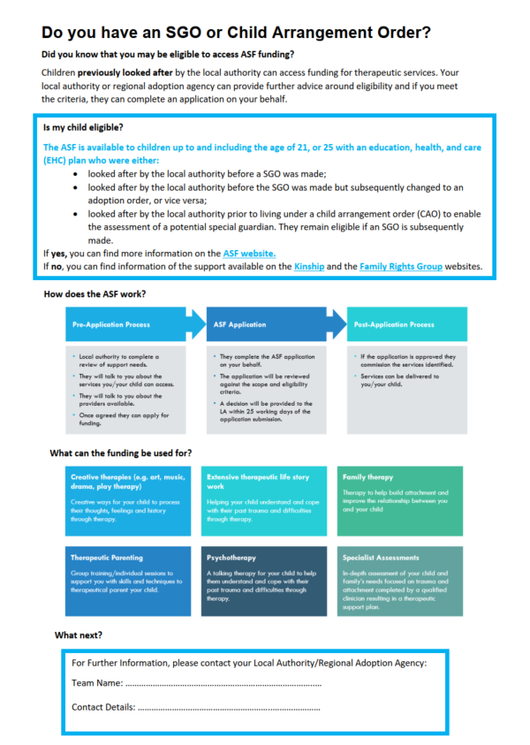



Resources
Notes:
Sally
- The are lots resources that are available to you providing more information and detail on ASGSF.
SGO Awareness leaflet detailing what we have covered on the last few slides. You will be able to access this through your Local Authority.
Kinship Compass - Information about the adoption and special guardianship support fund for kinship carers, including how to apply and who is eligible.
First 4 Adoption – General information on the scope and eligibility of the fund including helpful visuals.
Family Right Group – specific information on SG and the ASGSF, including the Kinship carers forum.

Slide 28
Useful information
ASGSF contact
Email
asf@mottmac.com
Helpline
01223 463 517
Family Rights Group > Get help and advice
Kinship > Home > Advice & Information > Adoption and Special Guardianship Support Fund
Gov.uk > Parenting, childcare and children's services > Adoption, fostering and surrogacy > Adoption
Notes:
Sharon

Slide 29
Kinship Care
Michelle Nye, Hampshire Virtual School Head

Slide 30

Kinship Care
Championing Kinship Care: The National Kinship Care Strategy
In February 2023, DfE published Stable Homes, Built on Love to respond to the Independent Review of Children’s Social Care.
In December 2023, DfE published Championing Kinship Care. Government has invested £20m of funding in 2024-25 to ensure there is well designed improvement across the kinship care sector so that kinship carers and children in kinship care arrangements feel supported, empowered, and heard.
As part of this, £3.8 million in 2024-25 to expand the role of Virtual School Heads to ensure that more children in kinship care receive the help they need to thrive at school

Slide 31
Kinship Care
The VSH non-statutory duty will be extended to specifically include championing the attendance, attainment and progress of children in kinship care from September 2024 to bring parity of support to kinship families who are currently not captured.
Promoting the education of children with a social worker and children in kinship care arrangements: virtual school head role extension - GOV.UK (www.gov.uk)
Kinship care includes children who may be living in an informal arrangement made by their parents, on a Child Arrangements Order or Special Guardianship Order, 'looked after' by the local authority and placed with kinship foster carers.
The remit of virtual school heads already includes kinship children:
  who are looked-after
  who meet the definition of previously looked-after
  with a social worker.
Virtual school heads should bring greater focus and visibility to the distinct needs of children in kinship care within their existing non-statutory responsibilities of CWSW.

Slide 32
Strategic activities
Raising awareness of the needs and disadvantage of children in different types of kinship care arrangements
Promoting practice that supports attendance and engagement of kinship children in education
Promoting practice that improves the educational attainment of children in kinship care
Expand the provision of advice and information, on request, to all kinship carers with special guardianship orders and child arrangement orders, regardless of whether their child was previously looked after by the local authority.
Additional activities for the extension to kinship care
Enhancing partnerships between education settings and the local authority so agencies can work together in a child focused manner
Identifying the needs of the cohort and addressing barriers to poor educational outcomes to ensure pupils make educational progress
Offering advice and support to key professionals such as social workers, designated teachers, designated safeguarding leads (DSL) and school leaders to help children make progress, including through increasing their confidence in using evidence-based interventions.

Slide 33
Current thinking …
Raise awareness of need
Emotional understanding of child’s journey
Identify/signpost services to support
Breaking into chunks what kinship means…what, who
Broaden understanding across CSD – E&I, C&F
Raise profile with and provide training to supporting services, e.g. SEN, HIEP, SALT
Support for grandparents/carers who may feel shame
Guidance for schools
Guidance around GDPR
Pupil voice
Encourage aspirational thinking

Slide 34
Mapping our practice

Slide 35
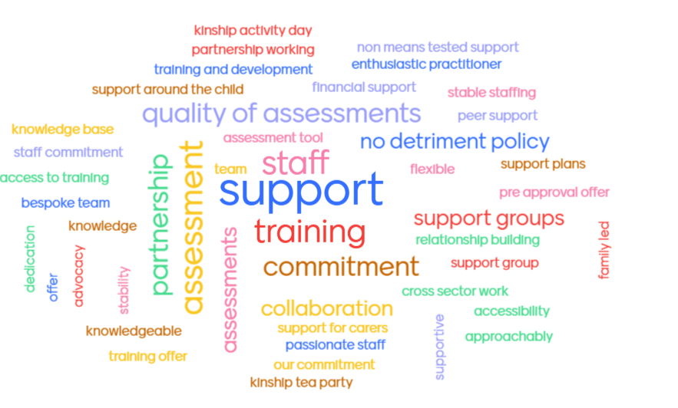
What we identified as strengths today July 2024
76 responses from 33 participants

Slide 36
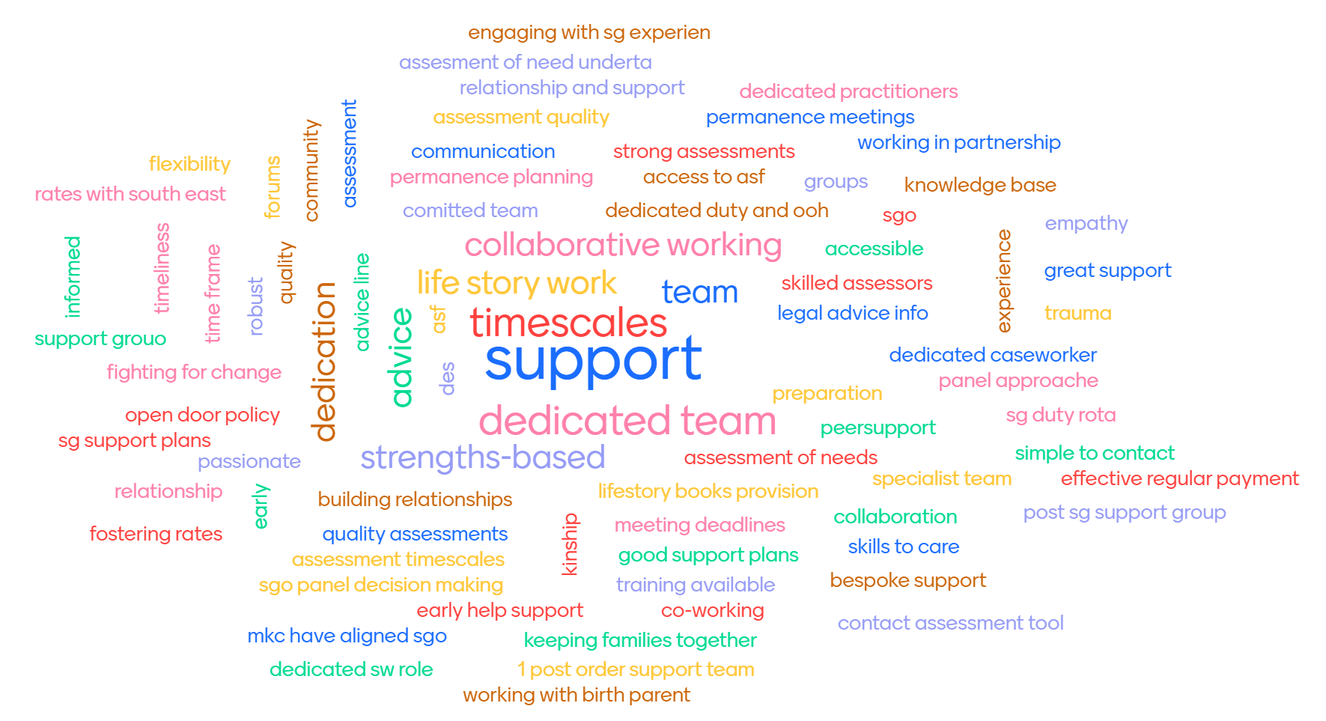
What you identified as strengths last time in 2022

Slide 37
Resetting priorities

Slide 38
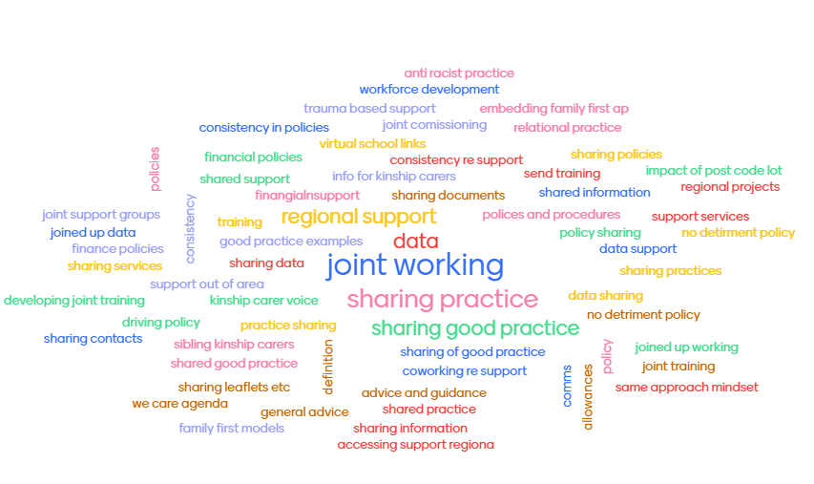
What you identified as priorities today July 2024
74 responses from 33 participants

Slide 39
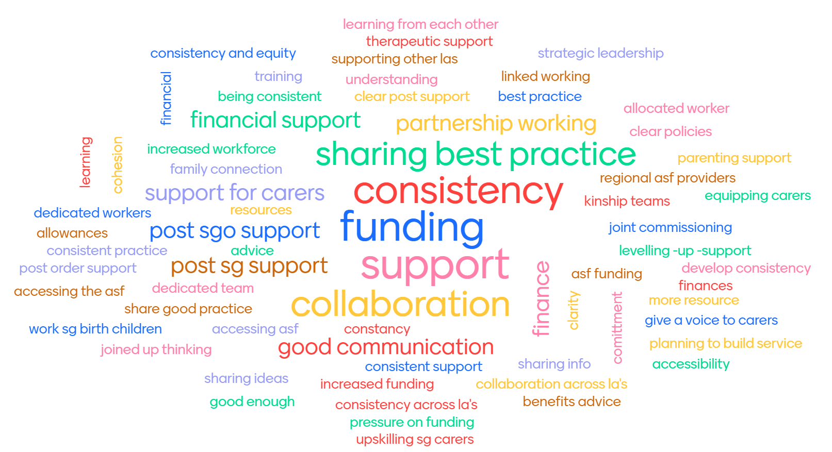
What you identified as priorities last time in 2022

Slide 40
What next
A huge amount of insight on best practice was gathered at the conference and this is being written up. A number of priorities were also identified for the region’s Kinship leadership group. The group will consider these priorities and how they are taken forward at their next meeting on 18 November 2024 2-3.30pm.
If you would like to attend this meeting and do not have an invite please contact rebeccaeligon@gmail.com

