Slide 1
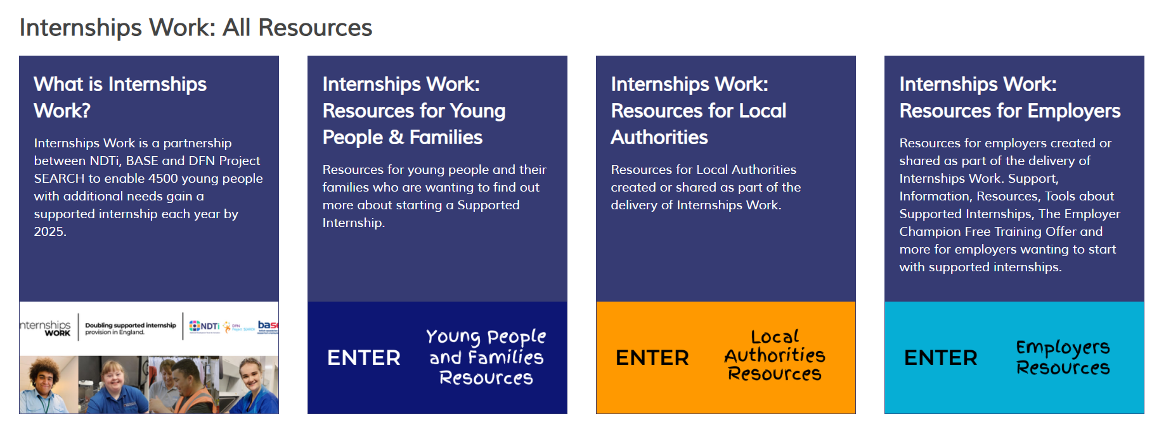
PfA resources - employment

Slide 2
PfA Resources - health
Transition guidance - Quality Statements
Notes:
NDTI read and talk about the slide
Title: PfA Resources – health
Ready Stead Go Programme
10 steps to transition

Slide 3
PfA resources – friends, relationships and community

Slide 5
Useful checklists
Annual Review Checklist (from year 9)
A simple aide memoir designed around the four pathways to ensure young people and families are given information they need, are signposted to relevant resources of support and are enabled to plan for a positive future.
Post 16 Checklist
A high level, simple document to help local areas make sure they are working on the themes that need to be tackled if young people are going to be supported well into adulthood.
Notes:
Title: Useful checklists
Annual Review Checklist (from year 9)
A simple aide memoir designed around the four pathways to ensure young people and families are given information they need, are signposted to relevant resources of support and are enabled to plan for a positive future.
Post 16 Checklist
A high level, simple document to help local areas make sure they are working on the themes that need to be tackled if young people are going to be supported well into adulthood.

Slide 6
PfA resources – Independent Living

Slide 7
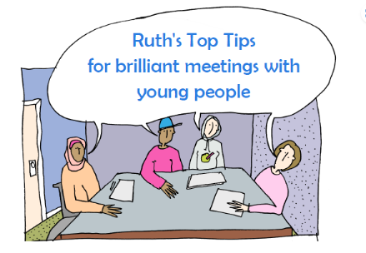
PfA tools and resources
Notes:
NDTI read and talk about the slide
Title: PfA tools and resources

