Slide 1
South East regional Wider fostering community project October 2025

Slide 2
Agenda
Item | Slide no
introductions | 5 mins
Mapping other related projects/schemes and setting out how this is different | 20 mins
Identifying legal and finance leads | 5 mins
Recruiting potential participants for design group | 20 mins

Slide 3
Reminder of project plan
 | Sept 25 |  |  |  |  | Oct 25 |  |  |  | Nov 25 |  |  |  | Dec 25 |  |  |  |  | Jan 26 |  |  |  | Feb 26 |  |  |  | March 26
w/c | 1 | 8 | 15 | 22 | 29 | 6 | 13 | 20 | 27 | 3 | 10 | 17 | 24 | 1 | 8 | 15 | 22 | 29 | 5 | 12 | 19 | 26 | 2 | 9 | 16 | 23 | 2 | 9 | 16 | 23 | 30
Co-design
Mapping
Service design
Marketing and comms
Governance
Recruit design group
Foster carer design group
Foster carer design group
Foster carer design group
Foster carer design group
Foster carer design group
Map existing practice, articulate how this project is different from current practice.
Design approval process, tiered payment, management oversight, QA process, training package, types of activity they can and cannot support,
Design and cost scale of yr 1 pilot
Design branding, marketing approach connecting with LAFSE and new fostering hub in Sussexes
Project group
Project group
Project group
Project group
Project group
Project group
Project group
Regional fostering
Regional fostering
Regional fostering
Still need to confirm dates for AD group and DCS steering group

Slide 4
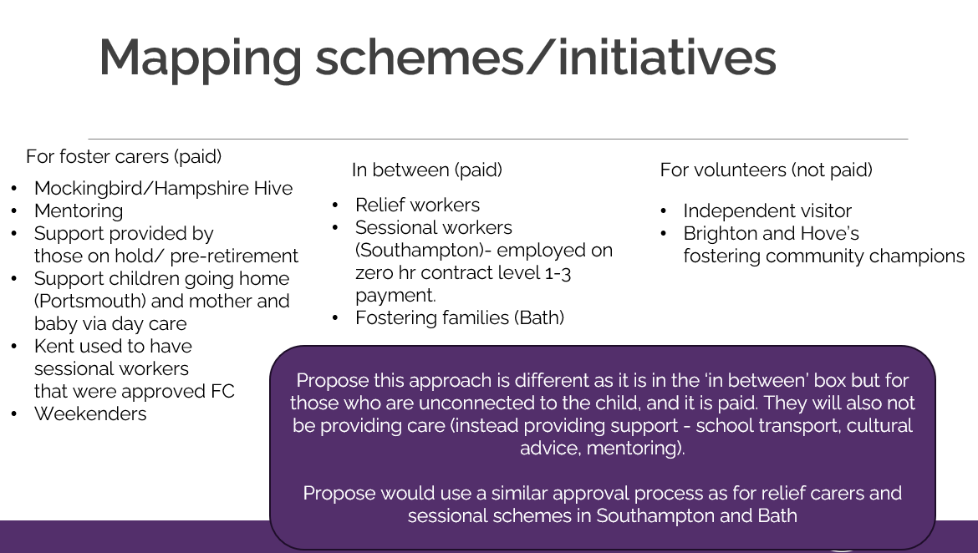
Are there any other schemes/initiatives we need to add?
In between (paid)
For volunteers (not paid)
Relief carers
Independent visitor
Brighton and Hove’s fostering community champions
Safe Families
Home for Good.

Slide 5
Identifying legal and finance leads
Has anyone got a good children’s legal or finance lead that could help with this?
We can provide up to £5k for legal input and £5k for finance input
Are we happy with the scope identified below?
LEGAL
FINANCE
If we provide figures about cost of recruiting a foster carer, cost of in-house fostering vs IFA vs residential, can they help with checking modelled invest to save costs (i.e. for every X people we recruit, we will reduce turnover in foster carers by x% and save £X)
Is the proposed approach to approval legally compliant?
Can the proposed approach be considered a first step towards full approval?

Slide 6
Input from people with lived experience
People who have approached us who don't have a spare room: what sort of things would they like to help with? What do they think about the idea? What would they be prepared to do as a volunteer vs paid?
Care experienced people: what would have help them when they were in care, what sort of areas would they want to help with? what do they think about the idea? What would they be prepared to do as a volunteer vs paid?
Foster carer: what sort of practical help (not care) would be most useful?
Retiring foster carers: what would they like to give back/continue doing?
Sessional workers: people already working in this way (e.g. Southampton and Brighton and Hove) what are they doing, why is it working? What support, training do they need?
Birth adult children of foster carers: what sort of things would they like to help with? What do they think about the idea? What would they be prepared to do as a volunteer vs paid?

Slide 7
South East regional Wider fostering community project Appendix: project scope and project plan

Slide 8
Introduction and contents
This appendix sets out the intended scope and delivery of the Fostering Community project. It is for discussion at the autumn Fostering leaders meeting chaired by Sarah Daly.
Item | Slide no
Scope agreed with DfE | 3
Governance and project team | 4
Cohorts | 5
Areas of delivery by March 2026 | 6
High level project plan | 7
Possible budget allocation | 8
Appendix (project steering group) | 9

Slide 9
DfE agreed scope
We know there is a shortage of foster carers and that there are sufficiency issues across the region and nationally. This project will be to develop and cost options for wider community involvement, ensuring safeguarding and compliance with legislation. For example, we know there are many people who have the right values and are keen to help in small ways, but for many reasons they cannot be a foster carer. The intended outcome of this project is that every community member with something to give to fostering is supported and enabled to help, rather than being turned away.
This help from the wider community might be as small as teaching foster carers how to make food from the country of children's origin, help with hair, regular transport, acting as a regular babysitter, or weekend respite carer building a relationship with an individual child, or it may include other aspects of one off or ongoing support. This aligns with FFCP direction of travel keeping children in communities and the McAllister review around ensuring children have loving relationships.
Year one (2025-26) is for research, design scoping and business case development which will include:
mapping existing practice and projects in this area
developing the systems and processes for approval (developing legally compliant alternative approaches to full approval) focusing on being as streamlined and flexible as possible
designing appropriate oversight/QA of any models we might want to test
develop a costed case (included definition of what are volunteering roles, vs paid roles and likely costs)
convene a service design group including families to co-develop possible new approaches for implementation in the new financial year.
In year two (2026-27) we intend to test these approaches in LAs in the South East. Costs for year two will be scoped in year one and will be subject to agreement and further discussion.
This project is intended to:
Prevent placement breakdown by packing more support around foster carers
Explore whether this approach could create a pipeline for future carers, who might not yet be ready, but with support and time could be foster carers of the future
Provide opportunity to existing foster carers who may be ready to retire but still want to support
The project will be sponsored by Sarah Daly, DCS Portsmouth and DCS sponsor for fostering, and will be overseen by the regional fostering leaders group
SESLIP-RIP-2025-26-and-RIIA-Grant-delivery-plan-18.7.2025-publication-version.pdf
Page 12

Slide 10
Governance and project team
DCS oversight
Reports to SESLIP DCS steering group quarterly alongside other DfE funded projects, escalating any delivery risks and issues that cannot be resolved elsewhere
AD group
Reports to SESLIP AD group quarterly as a short info item
Project governance (chaired by SRO Sarah Daly)
Reports to SESLIP fostering leaders group quarterly and DCS SRO Sarah Daly Key group to provide oversight. Purpose to keep all SE fostering leaders informed and involved
Project steering group
Made up of reps from Kent, Brighton and Hove, East Sussex, West Sussex, Milton Keynes and Portsmouth (named leads in appendix). This group meets at least monthly to oversee all project deliverables and is also involved in task and finish groups in key areas (see slide 9)
Project lead/coordinator
Rebecca Eligon SESLIP
Coordinates and facilitates all design work, project manages, ensures timely updates to rest of governance and DfE. Flags any issues that require strategic resolution to DCS fostering chair, Sarah Daly

Slide 11
Project will work with three key cohorts
Those stepping down (dual approved, foster carers, supported lodging etc)
Those who never want to be carers but want to help
(some might be geographical e.g. driving and some might not e.g. art therapist)
Those who want to be carers but have barriers
e.g. don’t have room, childcare experience, partner opposed, not ready/time not right

Slide 12
What we need to do by March…
Approval
What is the approval process (likely based on back up/relief approval)
Management and QA
How will support and management oversight work (who and how it would be coordinated).
Who will run approval process (in the 6 LAs individually, centrally on behalf of region)
Design how we will measure quality and impact
Training
What would be the minimum that would be expected. Design a programme to test in yr 2
Step up/ process to become full foster carers– progressive approval
What would this look like
Map existing practice
Under the three groups what do we already offer (e.g. sessional, IV)
Scale of pilot
How big it will be in yr 1.
Co-design
Work with families so they are involved in the design process
Pay scale
Set out proposed payments for different types of support. Need to develop a tiered model
A name and design
How do we describe and brand it, how do we communicate it
Articulate the difference
Describe how it is different from independent visitors, mentors, sessional foster carers

Slide 13
High level project plan
 | Sept 25 |  |  |  |  | Oct 25 |  |  |  | Nov 25 |  |  |  | Dec 25 |  |  |  |  | Jan 26 |  |  |  | Feb 26 |  |  |  | March 26
w/c | 1 | 8 | 15 | 22 | 29 | 6 | 13 | 20 | 27 | 3 | 10 | 17 | 24 | 1 | 8 | 15 | 22 | 29 | 5 | 12 | 19 | 26 | 2 | 9 | 16 | 23 | 2 | 9 | 16 | 23 | 30
Co-design
Mapping
Service design
Marketing and comms
Governance
Recruit design group
Foster carer design group
Foster carer design group
Foster carer design group
Foster carer design group
Foster carer design group
Map existing practice, articulate how this project is different form current practice.
Design approval process, tiered payment, management oversight, QA process, training package, types of activity they can and cannot support,
Design and cost scale of yr 1 pilot
Design branding, marketing approach connecting with LAFSE and new fostering hub in Sussexes
Project group
Project group
Project group
Project group
Project group
Project group
Project group
Regional fostering
Regional fostering
Regional fostering
Still need to confirm dates for AD group and DCS steering group

Slide 14
Possible budget allocation
An indicative budget of £45,000 has been allocated this financial year to develop and scope this project to then be delivered as a pilot in year 2.
Budget area | What is it
Co-design group | Design group with up to 10 foster carers/people with lived experience who attend 6 x monthly design sprints (1-2 hrs online) and are paid £30 per session | £1,500
Project management and design | Project management, design and facilitation of all workshop, writing business case and project plan for yr 2 implementation | 6 days a month (equiv to 1.5 days a week) at £625 a day x 7 months £26,250
Input from financial legal | One LA to provide legal and one to provide financial capacity to help build business case | £5,000 £5,000
Possible consulting input from Corum BAAF or fostering network | To consider proposed light touch approval process | £7,000
 | total | £44,750

Slide 15
Project steering group
Brighton and Hove
Cathy Seiderer
Lindsey Cotterill-Hay
West Sussex
Kelly Wilkes
East Sussex
Siobhan Edwards
Fiona Lewis
Kent
Maria Cordrey
Stacey Waters (lead)
Milton Keynes
Alison Miller
Portsmouth
Kerry Richards, Dave Crewe, Jackie Clark
Hampshire
Sarah Smith
Southampton
Carly Arnold
SESLIP project lead
Rebecca Eligon

