Slide 1



East Sussex Parent’s Forum
With James, Lee and Katie

Slide 2
Setting up
Important to ensure that parents involved in the initial set up had good scaffolding around them
Where needed, visits to each parent
Be clear about what the forum can and can’t do
When asked to give views on a specific piece of work/practice, important that it’s clear how it will be communicated back as to how these have/haven’t been incorporated, if they haven’t then an explanation as to why.
Parent led – even when I have an agenda, if that isn’t right on the day we meet then we don’t follow it!

Slide 3
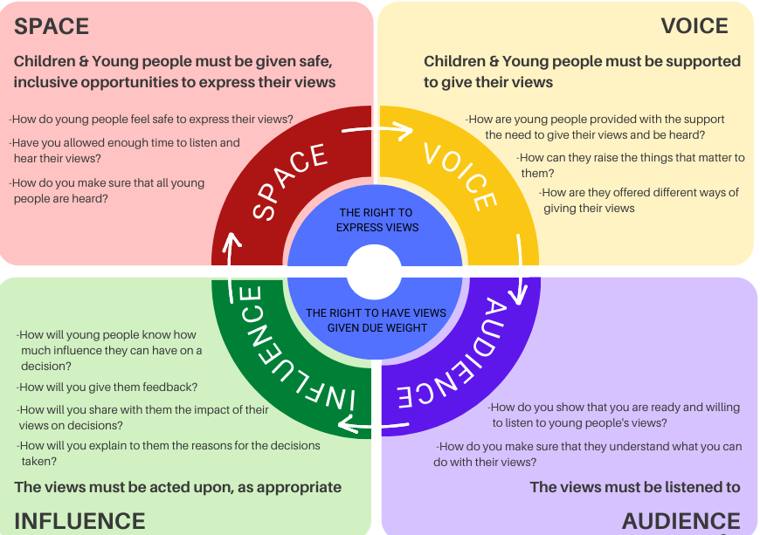
The Lundy Model of Participation
Notes:
The Lundy Model, developed by Professor Laura Lundy at Queens University Belfast in 2007 helps us understand the conditions that need to be present, if we are to deliver on Article 12 of the CRC with transparency and integrity.
The model clearly sets out four criteria that must be fulfilled to help inform understanding of participation and support improvements in practice. The concepts within the Lundy Model are interrelated and do more than identify strength and weaknesses in practice, they can help improve it. Each of the four elements must be considered, in order. If any one of the elements is missed out, it undermines the process itself and will impact the final outcome.
Tips
Always link to Article 12 when speaking of any form of pupil engagement/voice/participation and be sure to reference it as a right.
. You said – We did … and beyond: Close the feedback loop!
. Mind the gap! – Adult perception/Pupil view
. Do adults ‘get it’? Adults are typically the people who currently hold most of the ‘power’ in school, so it’s essential for them to see the benefit of empowering pupils if it is to work successfully.
. Pupils evaluate present practice
. Invest – Resources, definitely time and maybe money, will be needed. Use the Lundy model to figure out what’s required.
. Beyond the Council – Don’t rely on a single ‘voice’ mechanism, the goal isn’t to tick the box, it’s to create a culture of collaboration.
. Training – For adults and pupils
. Inclusivity audit regarding participation – Every child has the right to share their views, so think about equity.
. Learning to listen – staff training need?
. So what? Meaningful impact
. OK, what next?
. Link to campaigning: Check out the work of UNICEF Youth Ambassadors for inspiration.

Slide 4
Work we’re currently delivering
Supporting one another!
Consulting on East Sussex Family First – currently focused on the new Single Assessment.
Co-production of World Social Work Day Event.
Setting up regular coffee mornings for parents in East Sussex who are working/have worked with Children’s Social Care.
Co-production of new communication books for Family Time Service.
Working towards our ambition to have a parent mentoring programme in East Sussex.

Slide 5
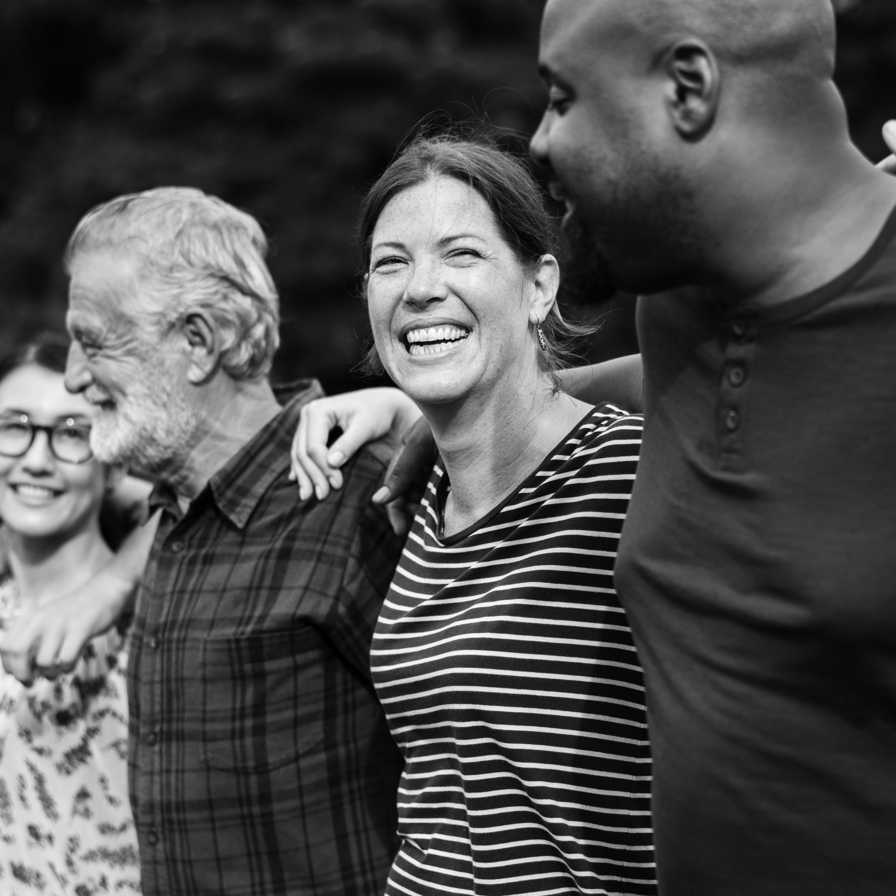
Parent’s Forum
Co-production
Structure
Lived experience
Support
Community
Trying to make change

Slide 6

What the Parent’s Forum means for us…

