Slide 1
Ordinarily Available Provision (OAP)
For FE Settings

Slide 2
National Context
“Building a system that leaves no learner behind - delivering high‑quality education and training for all.”
Ofsted
Ofsted defines strong inclusion as leaders embedding high expectations and removing barriers so all learners can access, experience and benefit fully from the provision.
White Paper
The FE White Paper sets out an ambition to strengthen inclusion within FE, helping reduce the risk of young people becoming NEET through strong teaching and effective support.

Slide 3
National Context
“settings will be expected to use their funding to understand the needs of their cohort and strategically plan to implement whole-setting approaches to inclusion...”
The Universal Offer
The Inclusive Mainstream Fund supports mainstream settings to deliver a strong, inclusive universal offer.
This involves:
- Inclusion is planned at whole‑setting level
- Barriers to learning are addressed early
- Support is embedded in everyday teaching and environments
A strong universal offer benefits all learners, not only those with SEND.
Notes:
Inclusive mainstream fund: best practice for 16 to 19 settings - GOV.UK

Slide 4
Add layers of support here

Slide 5
Current national challenges and trends
Variability in practice
Ofsted notes inconsistent practice has negative impact on groups of learners.
Rising learner need
White Paper identifies SEND, disadvantage and mental health as significant predictors of NEET risk.
Behaviour linked to unmet need
Ofsted frames behaviour through a lens of wellbeing, barriers and unmet need, rather than simply conduct.

Slide 6
DREAM supports the relational and environmental conditions that allow UDL‑designed lessons to work in practice
Dialogue
Regulation
Environment
Agency
Multi-Sensory

Slide 7
DREAM does not replace existing practice - it provides a shared language and structure for what effective inclusion already looks like.

Slide 8
Dialogue – how we communicate
Dialogue is about making communication accessible, clear and relational.
Many learners experience:
Speech, Language and Communication Needs (SLCN)
Processing delays
Anxiety around failure or public responses
Ordinarily available practice includes:
Verbal and visual instructions
Pre‑taught and displayed vocabulary
Tasks chunked into clear steps
Processing and wait time
Calm, non‑confrontational language

Slide 9
Regulation – readiness to learn
Regulation supports learners to feel safe, settled and ready.
Behaviour is increasingly framed through:
Wellbeing
Unmet need
Emotional regulation
Ordinarily available practice includes:
Predictable routines and lesson structures
Clear transition cues and time signposting
Emotional check‑ins
De‑escalation before sanction
Staff modelling calm, regulated responses

Slide 10
Environment – physical and psychological
Inclusive environments reduce barriers before learners struggle.
Ordinarily available practice includes:
Clear, uncluttered slides and resources
Consistent classroom layouts and routines
Access to quiet or lower‑stimulus spaces where possible
Clear visual agendas and lesson timelines
High contrast, accessible fonts and layouts
Why this matters:
When environments are predictable and accessible, learners spend less energy coping – and more energy learning.

Slide 11
Agency – choice and ownership
Agency is about giving learners appropriate control and voice in their learning.
This is particularly important for learners with:
Anxiety
Trauma histories
Negative prior educational experiences
Ordinarily available practice includes:
Choice in how learners demonstrate understanding (write, speak, record, demonstrate)
“Low floor, high ceiling” task design
Explicit teaching of learning as a process, including mistakes
Feedback focused on effort and strategy, not fixed ability

Slide 12
Multi‑Sensory – UDL in action
This aligns directly with Universal Design for Learning (UDL).
Ordinarily available practice includes:
Combining spoken explanation with visuals and written steps
Hands‑on, practical or movement‑based elements where appropriate
Chunked explanations with opportunities to practise
Use of assistive technology (read‑aloud, dictation, captions)
Short recap videos or visual summaries for independent access
Why this matters:
Multi‑sensory design supports working memory, attention and processing - benefiting all learners, not just those with identified SEND.

Slide 13
Breakout in to small groups
4/5 different scenarios (Simon to create)
How would expect DREAM to be implemented (what would you see, hear, experience?)
In different settings (e.g. animal care, motor mechanics, GCSEs / Functional Skills)

Slide 14
Potential CPD
Module | Focus Areas | DREAM Alignment
Intro and The Framework | Vision, Introduction to DREAM | Dialogue
The Design | Universal Design for Learning (UDL), Environment | Environment, Multi-Sensory, Dialogue, Agency
The Learner | Neurodiversity (ASC/ADHD), SLCN | Multi-Sensory, Dialogue, Agency
The Behaviour | ABCs, Trauma-Informed, Regulation, Growth Mindset | Regulation, Agency, Environment, Dialogue
The Delivery | Action Planning, Cascade Strategy, Assessment

Slide 15
Introduction & the DREAM Framework
Focus: Vision and shared language for inclusive practice.
Inclusion as an entitlement and standard, not an add‑on
Introduction to DREAM
Behaviour as communication
Why DREAM underpins Ordinarily Available Provision

Slide 16
The Design - Universal Design and Environment
Focus: Proactive inclusive curriculum design.
Universal Design for Learning (UDL) as the foundation
Designing for the margins so it works for everyone
Moving from reactive differentiation to planned inclusion
Environment and multi‑sensory design as OAP

Slide 17
The Learner - Neurodiversity and Communication
Focus: Understanding how learners experience FE.
Neurodiversity (ASC, ADHD) as difference, not deficit
Speech, Language and Communication Needs (SLCN)
Cognitive load and sensory overload
How unmet communication needs drive disengagement and behaviour

Slide 18
Behaviour, Regulation and Mindset
Focus: Supporting regulation rather than managing behaviour.
Behaviour as communication (ABC model)
Trauma‑informed approaches in FE
Regulation as a condition for learning
Growth mindset and reframing failure
Staff regulation and de‑escalation

Slide 19
Delivery and Implementation
Focus: Embedding DREAM across curriculum teams.
Coaching and cascade model
Reducing workload through improved design
Aligning DREAM with existing practice
Action planning for curriculum areas
Consistency without prescription

Slide 20
DREAM Self‑Audit
Use DREAM to evaluate OAP:
Dialogue: Are instructions always clear, visual and accessible?
Regulation: Are routines and transitions predictable?
Environment: Does the space reduce unnecessary sensory load?
Agency: Do learners have choice and voice?
Multi‑Sensory: Is learning accessed in more than one way?

Slide 21
Link National Inclusion Standards
DfE layers of support

Slide 22

Ordinarily Available Provision (OAP)
Notes:
The universal offer sets the expectation; Ordinarily Available Provision describes how that expectation is met in everyday FE practice

Slide 23
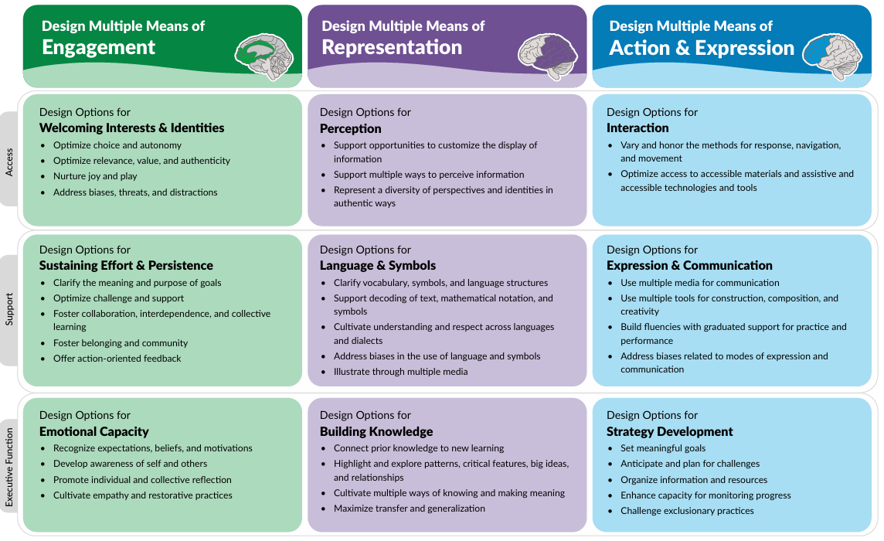
Universal Design for Learning
CAST (2024). Universal Design for Learning Guidelines version 3.0 [graphic organizer]. Lynnfield, MA: Author.

Slide 24
UDL vs. Differentiation
Traditional Differentiation | Universal Design for Learning (UDL)
Reactive: Adjusting the lesson after you realise a learner is struggling. | Proactive: Designing the lesson from the start to have built-in options.
Individual-Focused: Making a separate worksheet for "Learner A." | Environment-Focused: Making three versions of the task available to everyone.
High Lecturer Workload: Constant "retrofitting" for every lesson. | Sustainable: One high-quality, flexible resource used for all cohorts.

Slide 25
Add scenario here
How would you apply UDL

Slide 26
Example: Motor Mechanics / Motor Vehicle
Multiple Means of Engagement
Use real‑world scenarios (customer complaints, MOT issues) to build interest.
Provide movement-based roles (tool monitor, parts runner) that help regulate energy for learners with ADHD.
Multiple Means of Representation
Provide visual sequences for tasks like brake servicing, using photos or diagrams.
Use worked examples for multi-step maths/measurement tasks.
Offer QR codes linking to short recap videos for independent access.
Multiple Means of Action & Expression
Permit demonstration of understanding through:
  practical demonstration
  video explanation of fault diagnosis
  annotated photos of steps
  Provide cut-list templates and checklists to support working memory and organisation

Slide 27
Example: Animal Care
Multiple Means of Engagement
Begin sessions with predictable routines (animal checks, environment walkthrough)
Use authentic tasks (e.g., preparing enrichment materials) so learners understand real-world value.
Multiple Means of Representation
Create visual schedules for feeding/cleaning
Model handling techniques through demonstrations + diagrams + verbal explanation.
Provide laminated safety prompt cards at each station for quick reference.
Multiple Means of Action & Expression
Permit demonstration of understanding through:
  filming a safe animal‑handling routine
  creating a labelled enclosure diagram
  verbally explaining animal behaviour
  Offer structured “I do → we do → you do” scaffolding for new skills

Slide 28
Example: GCSE English / Maths
Multiple Means of Engagement
Start with low-stakes retrieval to build confidence and reduce fear of failure.
Make tasks personally relevant: e.g., percentages linked to payslips; English inference linked to workplace scenarios.
Multiple Means of Representation
Chunk complex processes (inference, algebra, problem‑solving) into small, modelled steps.
Use dual coding: colour-coded worked examples; diagrams for maths concepts; visual summaries of English extracts.
Provide scaffolds such as sentence starters and exemplar responses.
Multiple Means of Action & Expression
Allow learners to demonstrate their understanding in varied formats (such as voice notes, videos, annotated photos or practical explanations) so they can show what they know without being limited by writing fluency or processing barriers. Consider how assistive technology can be used to enhance this.

